Slide 1
Ecosystem Services

Slide 2
Definition: Ecological Services
The natural world provides us with the essential services we require for life.
These services are called ecological services – the interactions among organisms and their natural environments, including the cycling of water and basic nutrients that humans can use and capitalize on.

Slide 3
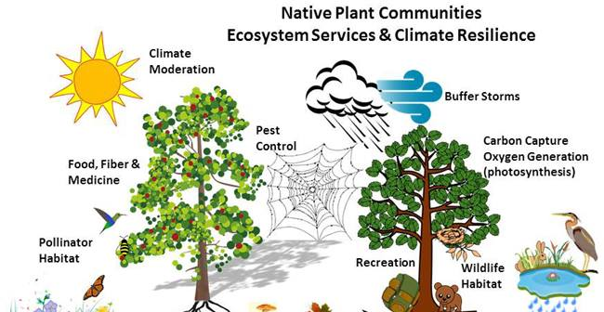

Slide 4
Examples of Ecological Services
Purification of air and water
Mitigation of floods and droughts
Detoxification and decomposition of wastes
Generation and renewal of soil and natural vegetation
Pollination of crops and natural vegetation
Control of the vast majority of potential agricultural pests

Slide 5
More Ecological Services
Dispersal of seeds and translocation of nutrients
Maintenance of biodiversity
Protection from the sun’s harmful ultraviolet rays
Partial stabilization of climate
Moderation of temperature extremes and the force of winds and waves
Support of diverse human culture
Providing aesthetic beauty and intellectual stimulation that lift the human spirit.

Slide 6
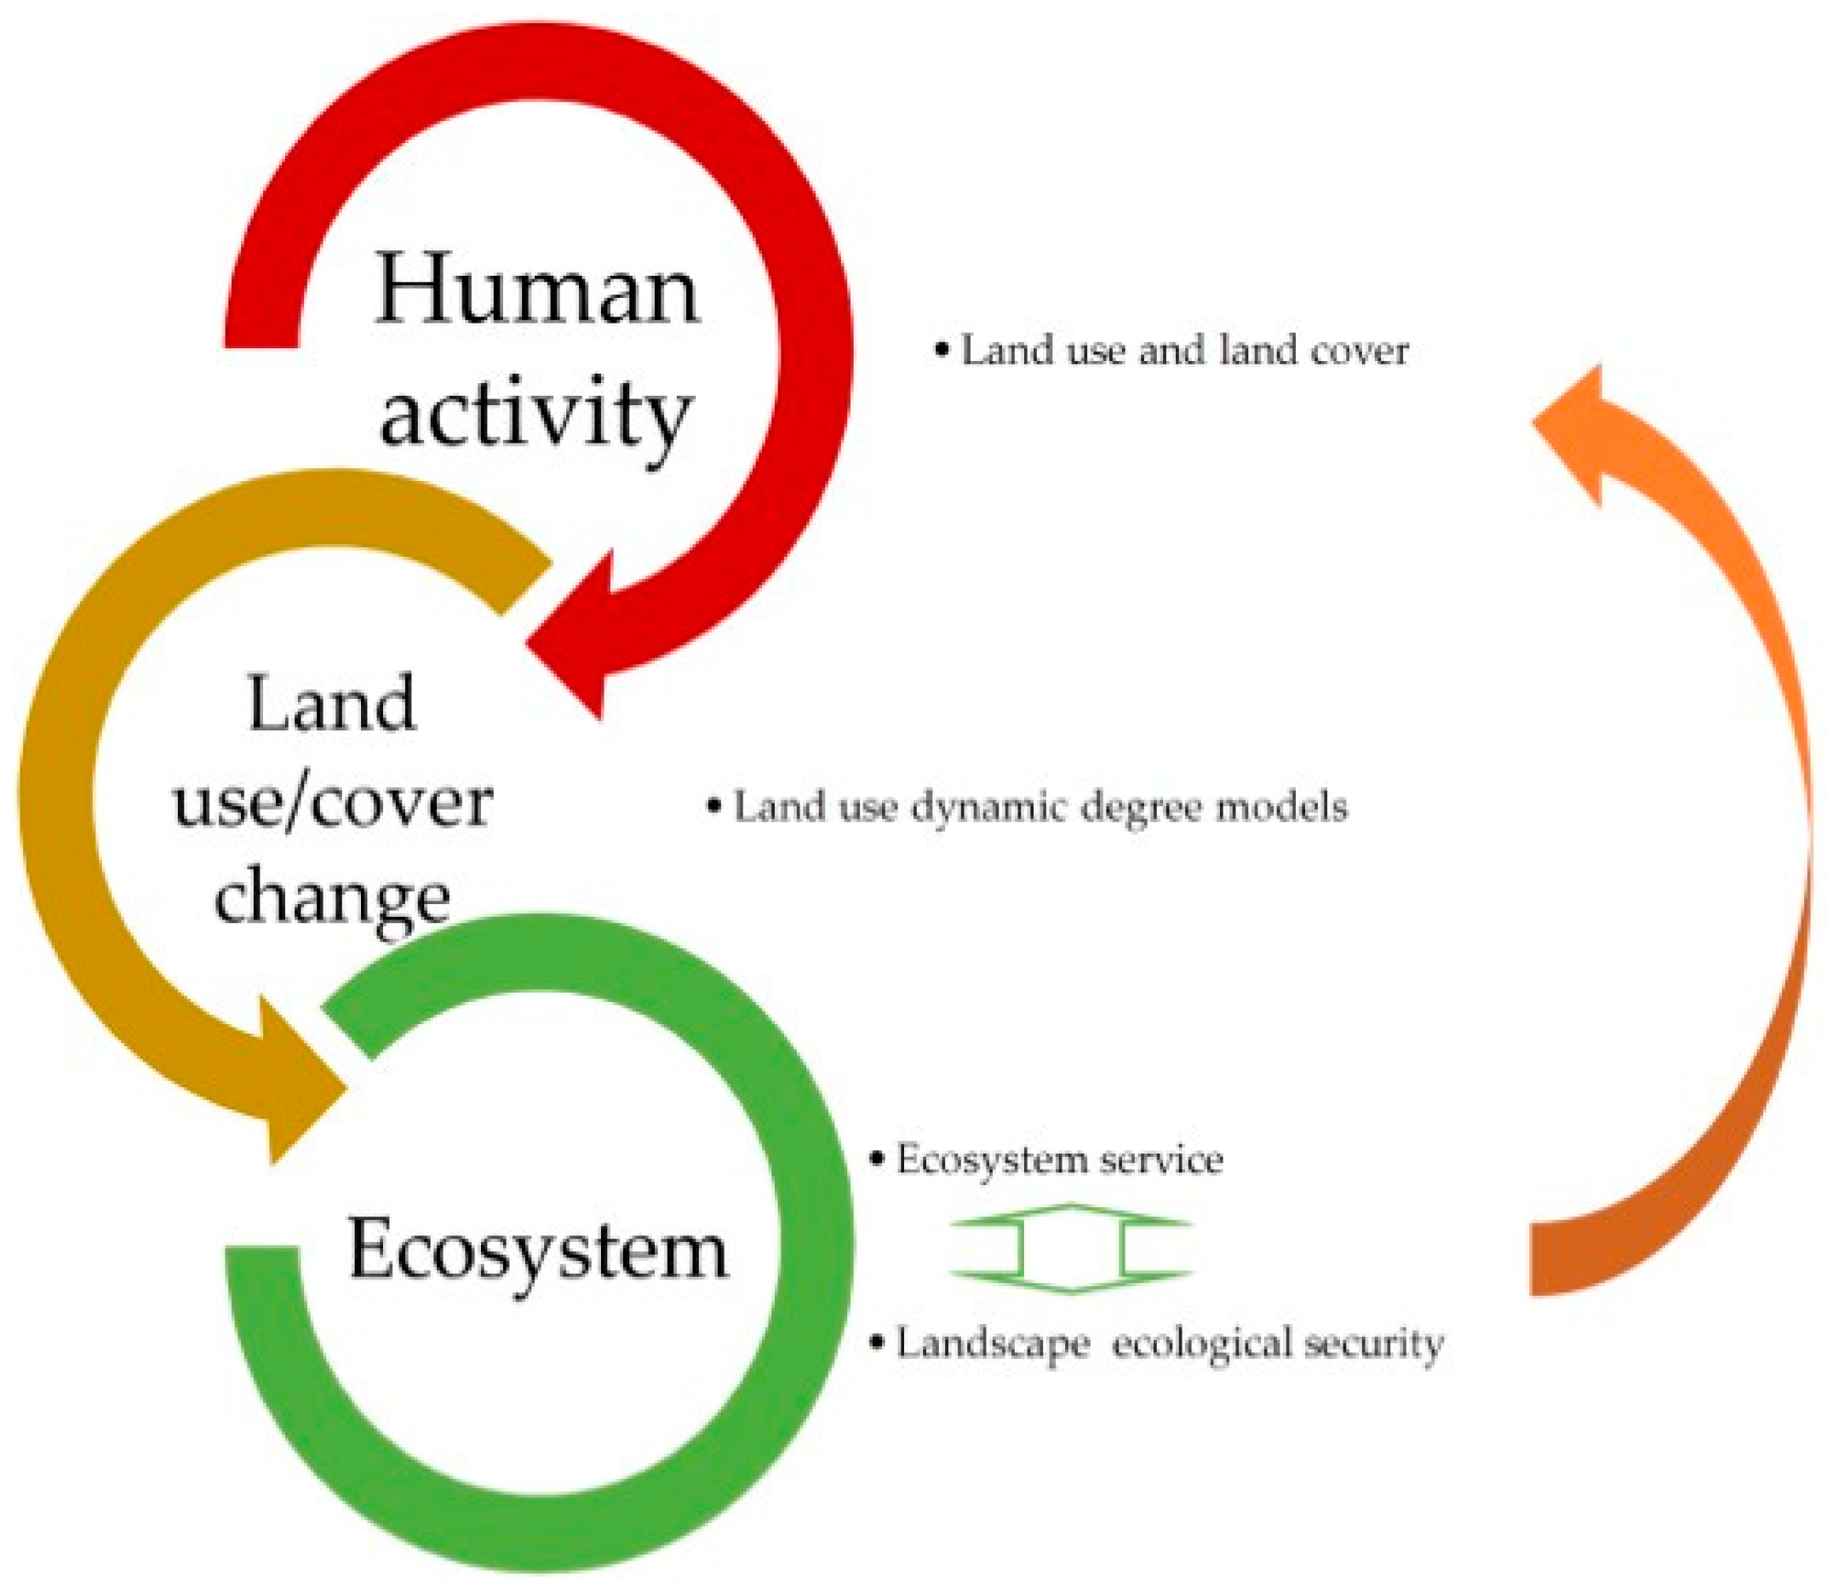

Slide 7
Threats to Ecological Services
Land-use change and irreversible conversion of landscapes and their ecological functions.
Disruption of bio-geochemical cycles i.e. nitrogen, carbon and phosphorus cycles.
Disruption of the water cycle and ground water recharge.
Invasion by or introduction of exotic (non-native) organisms.
Toxins, pollutants and human wastes.
Changes in chemical composition of the atmosphere and ozone depletion.
Climate change.

Slide 8
Get Involved
The choices we make can often have a impact on the quality of food, water and the natural environment.

Slide 9
What can you do?
Learn how and where products are made. Choose products produced with methods that conserve resources, minimize waste and reduce or eliminate environmental damage.
Buy locally produced products. This can help to reduce the amount of energy (natural resources) required to transport and store goods and supports local communities and economies.
Choose products made with methods that reduce or eliminate the use of pesticides and artificial fertilizers.
Become a volunteer steward.

Slide 10
What can you do?
Reduce personal consumption and waste production i.e. conserve water and use gray water (recycled water), reduce energy consumption and support renewable energy alternatives, compost, recycle, and reduce the use of disposable goods.
Use public transit, cycle or walk to conserve natural resources, reduce pollution and enjoy the health benefits.
Support smart growth and join or start a community garden.
Reduce the use of pesticides and herbicides, use native plants in your garden and lawn and provide habitat for wildlife.
Make consumer choices that recognized and pay producers and processors for being good stewards.

