Slide 1
Island Biogeography

Slide 2
Definition
Island biogeography examines the factors that affect the species richness of isolated natural communities.
The theory was developed to explain species richness of actual islands.
It has been extended to mountains surrounded by deserts, lakes surrounded by dry land, fragmented forest and natural habitats surrounded by human-altered landscapes.
Notes:
. The field was started in the 1960s by the ecologists Robert MacArthur and E.O. Wilson,^{[2]} who coined the term island biogeography, as this theory attempted to predict the number of species that would exist on a newly created island.

Slide 3
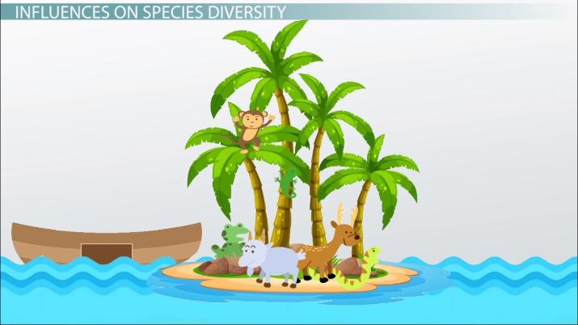
Now it is used in reference to any ecosystem surrounded by unlike ecosystems

Slide 4
What’s an island?
An "island" is any area of suitable habitat surrounded by an expanse of unsuitable habitat.
this may be a traditional island
It may also be an untraditional "islands", such as the peaks of mountains, isolated springs in the desert, or expanses of grassland surrounded by highways or housing tracts.
An island for one organism may not be an island for another: some organisms located on mountaintops may also be found in the valleys, while others may be restricted to the peaks.

Slide 5
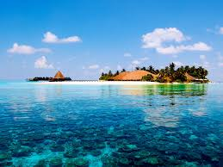
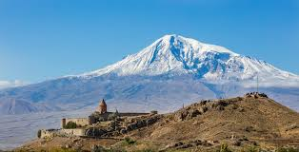
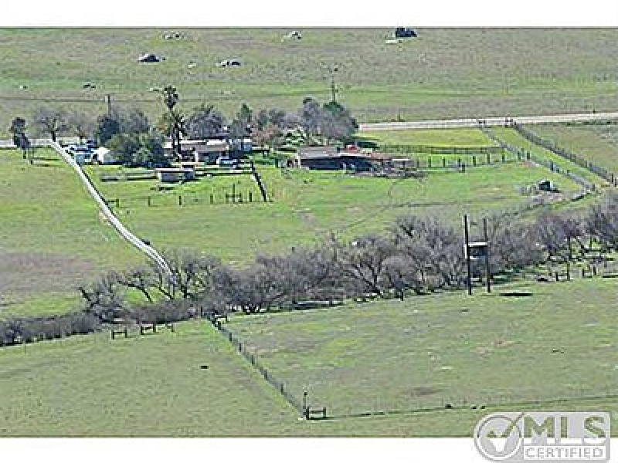
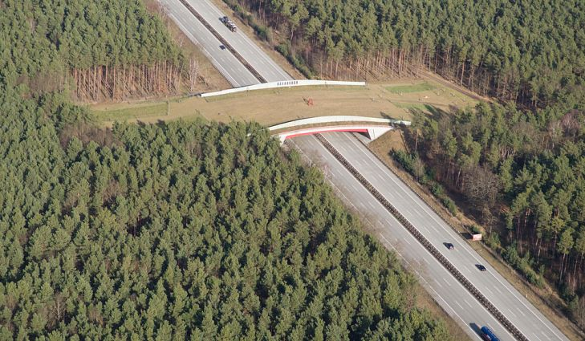

Slide 6
What does biogeography propose?
The number of species found on an undisturbed island is determined by immigration and extinction.
The isolated populations may follow different evolutionary routes
Immigration and emigration are affected by the distance of an island from a source of colonists (distance effect).
Islands that are more isolated are less likely to receive immigrants than islands that are less isolated.

Slide 8
Does island size matter?
The rate of extinction once a species manages to colonize an island is affected by island size
Larger islands contain larger habitat areas and opportunities for more different varieties of habitat.
Larger habitat size reduces the probability of extinction due to chance events.
Habitat heterogeneity increases the number of species that will be successful after immigration.

Slide 10
What factors matter?
Degree of isolation (distance to nearest neighbor, and mainland)
Length of isolation (time)
Size of island (larger area usually facilitates greater diversity)
The habitat suitability which includes:
Climate (tropical versus arctic, humid versus arid, etc.)
Initial plant and animal composition if previously attached to a larger land mass
The current species composition

Slide 11
More factors
Location relative to ocean currents (influences nutrient, fish, bird, and seed flow patterns)
Serendipity (the impacts of chance arrivals)
Human activity

Slide 12
What’s the concern?
Reserves and national parks formed islands inside human-altered landscapes (habitat fragmentation),
These reserves could lose species as they 'relaxed towards equilibrium' (that is they would lose species as they achieved their new equilibrium number, known as ecosystem decay)

Slide 13
Habitat Corridors Concerns
Island biogeography theory also led to the development of habitat corridors as a conservation tool to increase connectivity between habitat islands.
Habitat corridors can increase the movement of species between parks and reserves and therefore increase the number of species that can be supported
they can also allow for the spread of disease and pathogens between populations

