Slide 1
Urbanization

Slide 2
22-1 What Are the Major Population Trends in Urban Areas?
Urbanization continues to increase steadily, and the numbers and sizes of urban areas are growing rapidly, especially in less-developed countries

Slide 3
More Than Half of the World’s People Live in Urban Areas
Urbanization
Creation and growth of urban and suburban areas
52% of people live in such areas
Urban growth
Rate of increase of urban populations
Immigration from rural areas
Pushed from rural areas to urban areas
Pulled to urban areas from rural areas

Slide 4
More Than Half of the World’s People Live in Urban Areas (cont’d.)
Four major trends
Proportion of global population living in urban areas is increasing
Number and size of urban areas is mushrooming
Megacities; hypercities
Urban growth slower in developed countries
Poverty is becoming increasingly urbanized
Mostly in less-developed countries

Slide 5
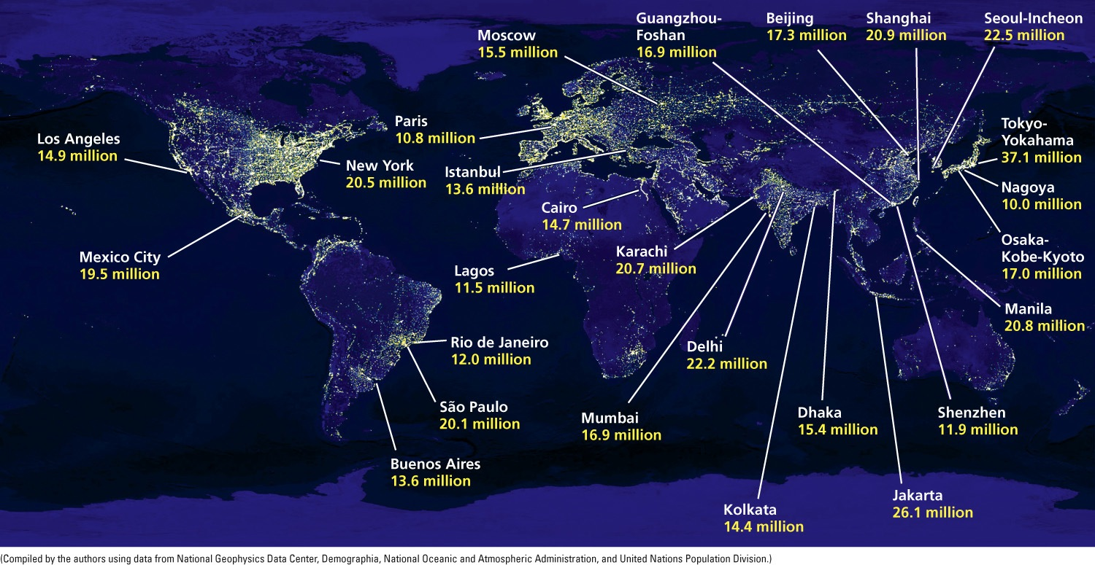
Fig. 22-3, p. 608
Notes:
Figure 22-3: Global outlook: Megacities, or major urban areas with 10 million or more people, in 2012. Question: In order, what were the world’s five most populous urban areas in 2012?

Slide 6
Case Study: Urbanization in the United States
Three phases between 1800 and 2008
Migration from rural areas to large central cities
Migration from large central cities to suburbs and smaller cities
Migration from North and East to South and West
Aging infrastructure
Deteriorating

Slide 7
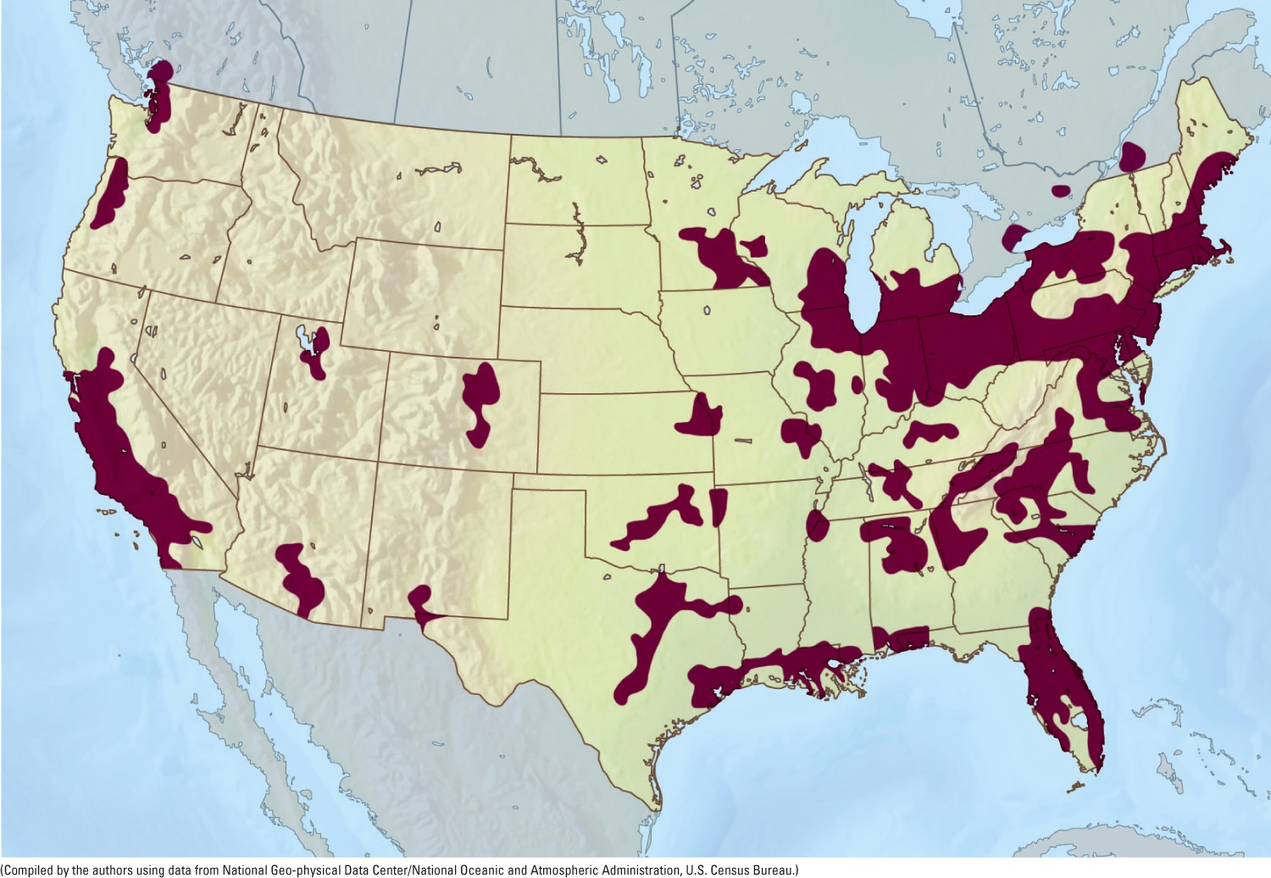
Fig. 22-5, p. 609
Notes:
Figure 22-5: Urban areas in the United States with more than 1 million people (shaded areas) where about 54% of Americans live. Questions: Why do you think many of the largest urban areas are located near water? What effect might projected climate change have on these urban areas?

Slide 8
Urban Sprawl Gobbles Up the Countryside
Urban sprawl
Low-density development at edges of cities/towns
Contributing factors to urban sprawl in the U.S.
Ample land
Low-cost gasoline – highways
Tax laws encouraged home ownership

Slide 9
Urban Sprawl Gobbles Up the Countryside (cont’d.)
Contributing factors (cont’d.)
State and local zoning laws
Multiple political jurisdictions – poor urban planning
What kinds of environmental and economic problems has urban sprawl caused?

Slide 10
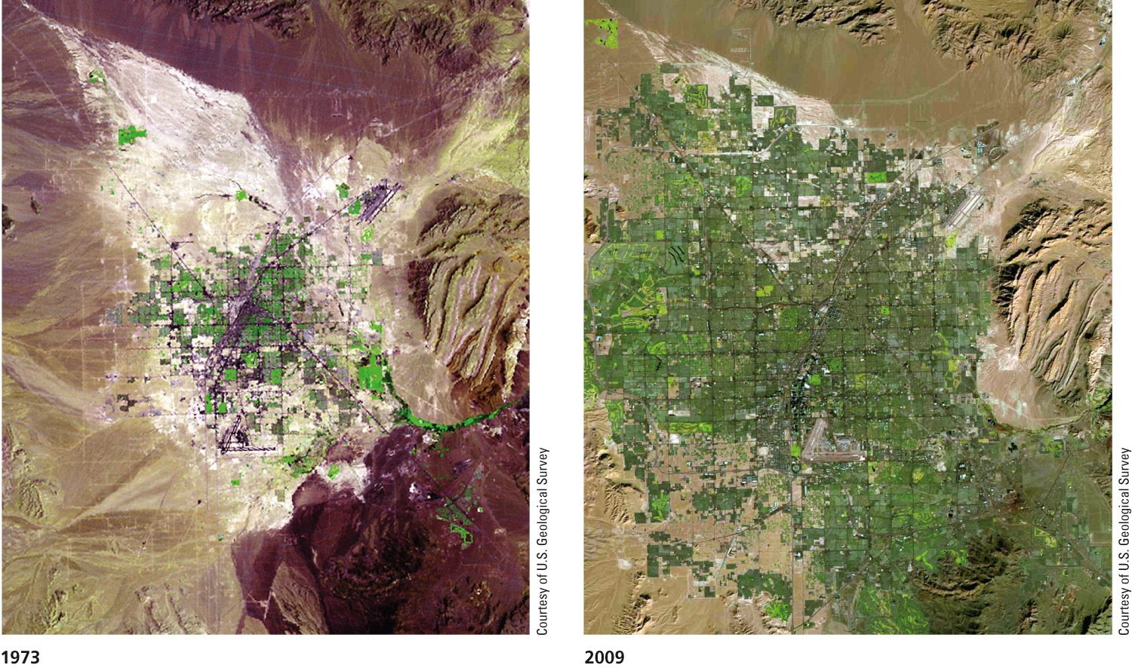
Fig. 22-6, p. 610
Notes:
Animated Figure 22-6: These satellite images show the growth of urban sprawl in and around the U.S. city of Las Vegas, Nevada, between 1973 and 2009. Question: What might be a limiting factor on population growth in Las Vegas?

Slide 11
Natural Capital Degradation
Urban Sprawl
Land and Biodiversity
Energy, Air, and Climate
Water
Economic Effects
Loss of cropland
Increased use
and pollution of
surface water and groundwater
Increased energy use and waste
Decline of downtown business districts
Loss and fragmentation
of forests, grasslands, wetlands, and wildlife habitat
Increased emissions of carbon dioxide and other air pollutants
More unemployment
in central cities
Increased runoff
and ﬂooding
Fig. 22-8, p. 611
Notes:
Figure 22-8: Some of the undesirable impacts of urban sprawl, or car-dependent development. Question: Which five of these effects do you think are the most harmful?

Slide 12
22-2 What Are the Major Urban Resource and Environmental Problems?
Most cities are unsustainable because of high levels of resource use, waste, pollution, and poverty

Slide 13
Urbanization Has Advantages
Centers of economic development, innovation, education, technological advances, and jobs
Recycling economically feasible
Preservation of biodiversity outside of urban areas
Mass transportation

Slide 14
Urbanization Has Disadvantages
Huge ecological footprints
Consume 75% of the world’s resources
Lack of vegetation
Water problems
Deprive wild and rural areas of water; flooding
Concentration of pollution/health problems
Air and water pollution
Solid and hazardous wastes

Slide 15
Urbanization Has Disadvantages (cont’d.)
Excessive noise
Noise pollution – impairs or interferes with hearing, causes stress or accidents
Altered climate and light pollution
Cities tend to be warmer, rainier, foggier, and cloudier than rural areas
Artificial light has affected some species

Slide 16
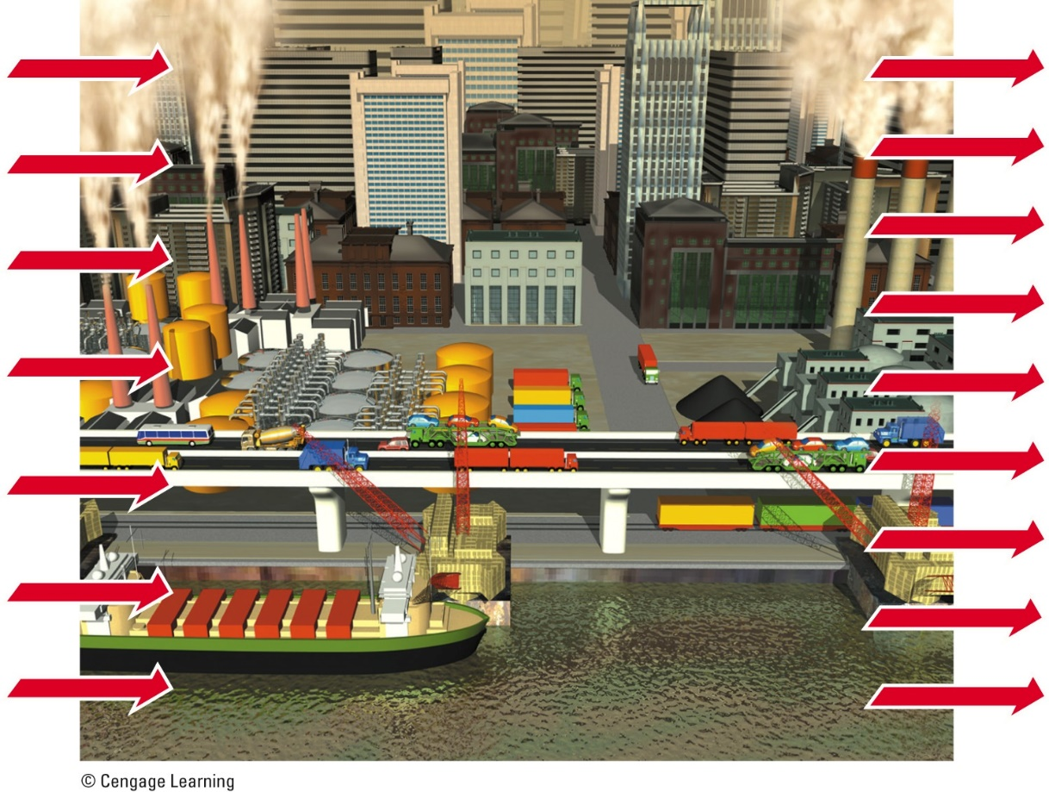
Inputs
Outputs
Energy
Solid wastes
Food
Waste heat
Air pollutants
Water
Water pollutants
Raw materials
Greenhouse gases
Manufactured goods
Manufactured goods
Noise
Money
Wealth
Information
Ideas
Fig. 22-9, p. 612
Notes:
Figure 22-9: Natural capital degradation. The typical city depends on nonurban areas for huge inputs of matter and energy resources, while it generates and concentrates large outputs of pollution, waste matter, and heat. Question: How would you apply the three scientific principles of sustainability (see Figure 1-2, p. 6 or back cover) to lessen some of these impacts?

Slide 17
Permanent damage begins after 8-hour exposure
Noise Levels (in dbA)
Normal breathing
Quiet rural area
Rainfall
Vacuum cleaner
Lawn mower
Rock music
Earphones
at loud level
Boom cars
Whisper
Quiet room
Normal conversation
Average factory
Chain saw
Thunderclap (nearby)
Air raid siren
Rifle
Fig. 22-10, p. 613
Notes:
Figure 22-10: Noise levels (in decibel-A [dbA] sound pressure units) of some common sounds. Question: How often are your ears subjected to noise levels of 85 or more dbA?

Slide 18
Life Is a Desperate Struggle for the Urban Poor in Less-Developed Countries
Slums
Areas dominated by dilapidated housing
Squatter settlements/shantytowns
Scavenged materials, on unoccupied land without the owner’s permission
Terrible living conditions
Lack basic water and sanitation
High levels of pollution

Slide 19
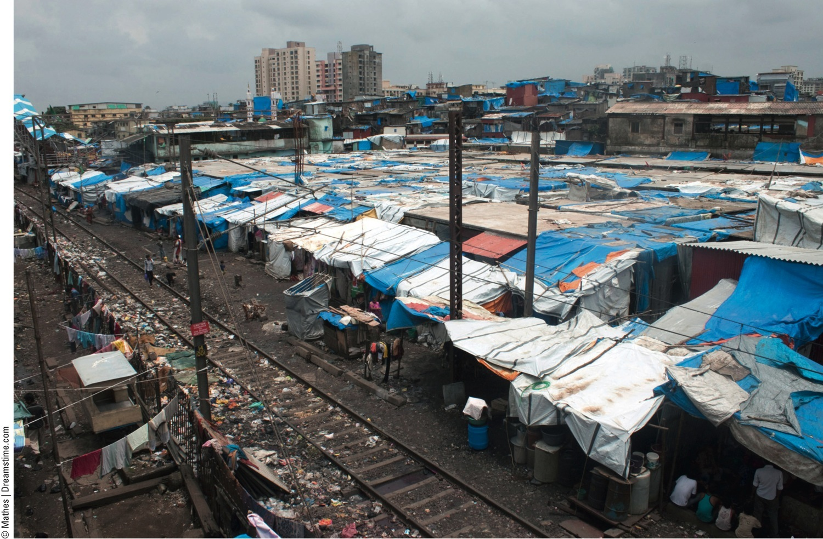
Fig. 22-11, p. 614
Notes:
Figure 22-11: Slum in Mumbai, India.

Slide 20
22-3 How Does Transportation Affect Urban Environmental Impacts?
In some countries, many people live in widely dispersed urban areas and depend mostly on motor vehicles for their transportation, which greatly expands their ecological footprints

Slide 21
Cities Can Grow Outward or Upward
Compact cities
Hong Kong, China
Tokyo, Japan
Mass transit
Dispersed cities
U.S. and Canada
Car-centered cities

Slide 22
Use of Motor Vehicles Has Advantages and Disadvantages
Advantages
Mobility and convenience
Jobs in:
Production and repair of vehicles
Supplying fuel
Building roads
Status symbol

Slide 23
Use of Motor Vehicles Has Advantages and Disadvantages (cont’d.)
Disadvantages
Accidents
1.2 million per year, 15 million injured
Kill 50 million animals per year
Largest source of outdoor air pollution
Helped create urban sprawl
Traffic congestion

Slide 24
Reducing Automobile Use Is Not Easy, But It Can Be Done
Full-cost pricing – high gasoline taxes
Consumer education
Funds for mass transit
Opposition from car owners and industry
Lack of good public transit is a problem
Rapid mass transit
Difficult to pass in the United States
Strong public opposition; dispersed nature of the U.S.

Slide 25
Reducing Automobile Use Is Not Easy, but It Can Be Done (cont’d.)
Other options for reducing automobile use
Raise parking fees
Tolls on roads, tunnels, and bridges into major cities
Charge a fee to drive into a major city
Car-sharing

Slide 26
Some Cities Promote Alternatives to Cars
Alternatives:
Bicycles
Heavy-rail systems
Subways, elevated rail, and metro trains
Light-rail systems
Streetcars, trolleys, and tramways
Buses
Rapid-rail system between urban areas

Slide 27
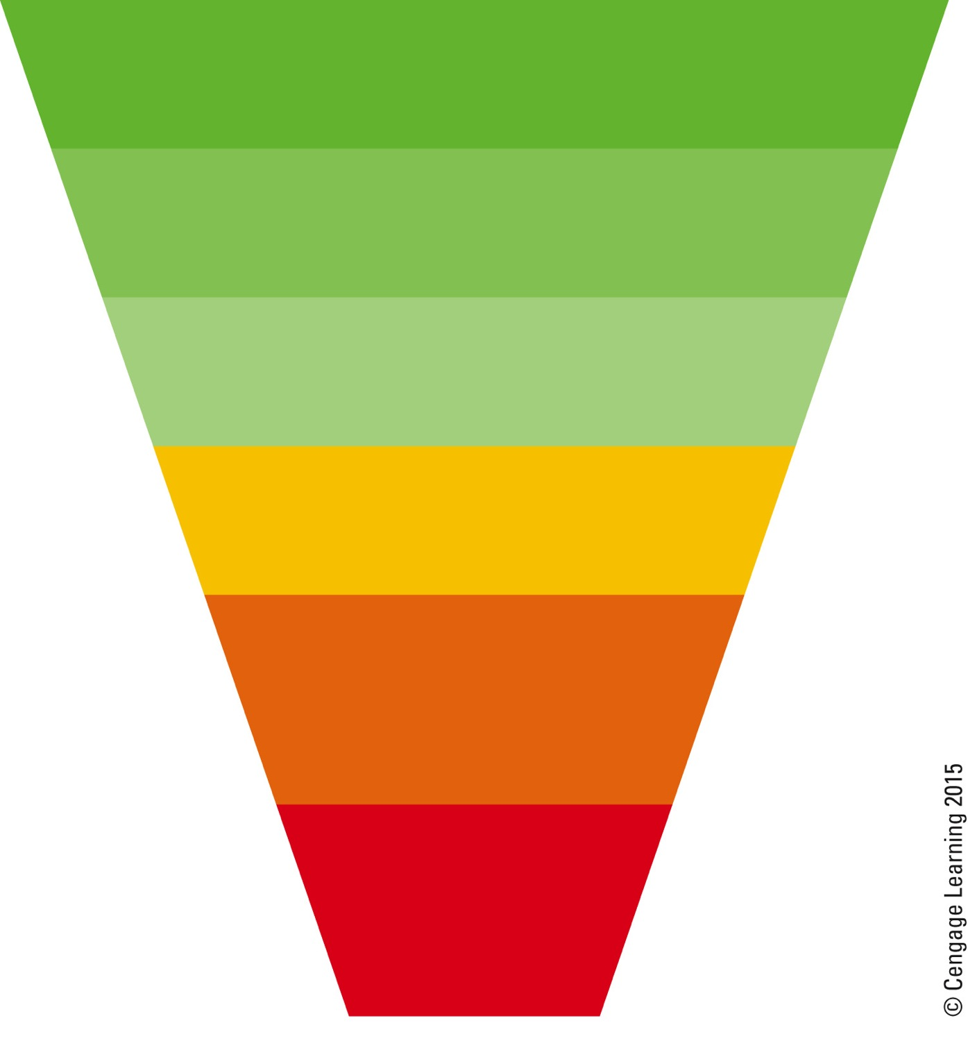
Transportation Priorities
Pedestrians
Bicycles
Public transportation
Commercial vehicles
Multiple occupancy vehicles
Single occupancy vehicles
Fig. 22-15, p. 617
Notes:
Figure 22-15: Transportation priorities in more sustainable cities.

Slide 28
22-4 How Important Is Urban Land- Use Planning?
Urban land-use planning can help to reduce uncontrolled sprawl and slow the resulting degradation of air, water, land, biodiversity, and other natural resources

Slide 29
Conventional Land-Use Planning
Land-use planning
Encourages future population growth
Encourages economic development
Zoning
Land designated for certain uses
Mixed-use zoning

Slide 30
Smart Growth Can Work
Smart growth
Reduces dependence on cars
Controls and directs sprawl
Cuts wasteful resource
Uses zoning laws to channel growth

Slide 31
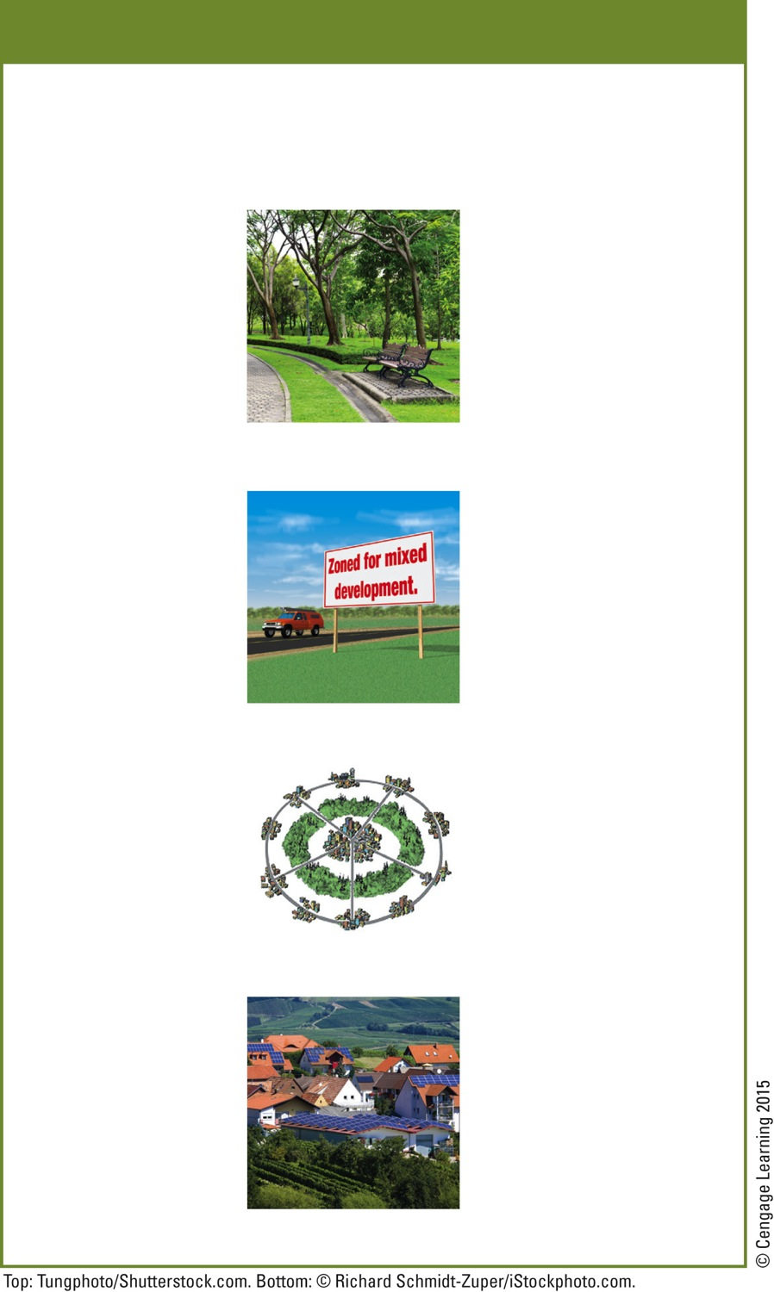
Solutions
Smart Growth Tools
Limits and Regulations
Protection
Preserve open space
Limit building permits
Buy new open space
Prohibit certain types of development
Draw urban growth boundaries
Create greenbelts around cities
Taxes
Tax land, not buildings
Zoning
Tax land on value of actual use instead of on highest value as developed land
Promote mixed use of housing and small businesses
Concentrate development along mass transportation routes
Tax Breaks
For owners agreeing not to allow certain types of development
Planning
For cleaning up
and developing abandoned urban sites
Ecological
land-use planning
Revitalization and New Growth
Environmental
impact analysis
Revitalize existing towns and cities
Integrated regional planning
Build well-planned new towns and villages within cities
Fig. 22-21, p. 620
Notes:
Figure 22-21: We can use these smart growth tools to prevent and control urban growth and sprawl. Questions: Which five of these tools do you think would be the best methods for preventing or controlling urban sprawl? Which, if any, of these tools are used in your community?

Slide 32
Preserving and Using Open Space
Urban growth boundary
U.S. states: Washington, Oregon, and Tennessee
Municipal parks
U.S. cities: New York City and San Francisco
Greenbelts
Canadian cities: Vancouver and Toronto
Western European cities

Slide 33
22-5 How Can Cities Become More Sustainable and Livable?
An eco-city allows people to:
Choose walking, biking, or mass transit for most transportation needs
Recycle or reuse most of their wastes
Grow much of their food
Protect biodiversity by preserving surrounding land

Slide 34
New Urbanism Is Growing
Conventional housing development
Many houses, standard-size lots
Cluster development
Housing and green space
New urbanism: environmental sustainability
Walk/bike friendly
Mixed use and diversity
Quality urban design

Slide 35
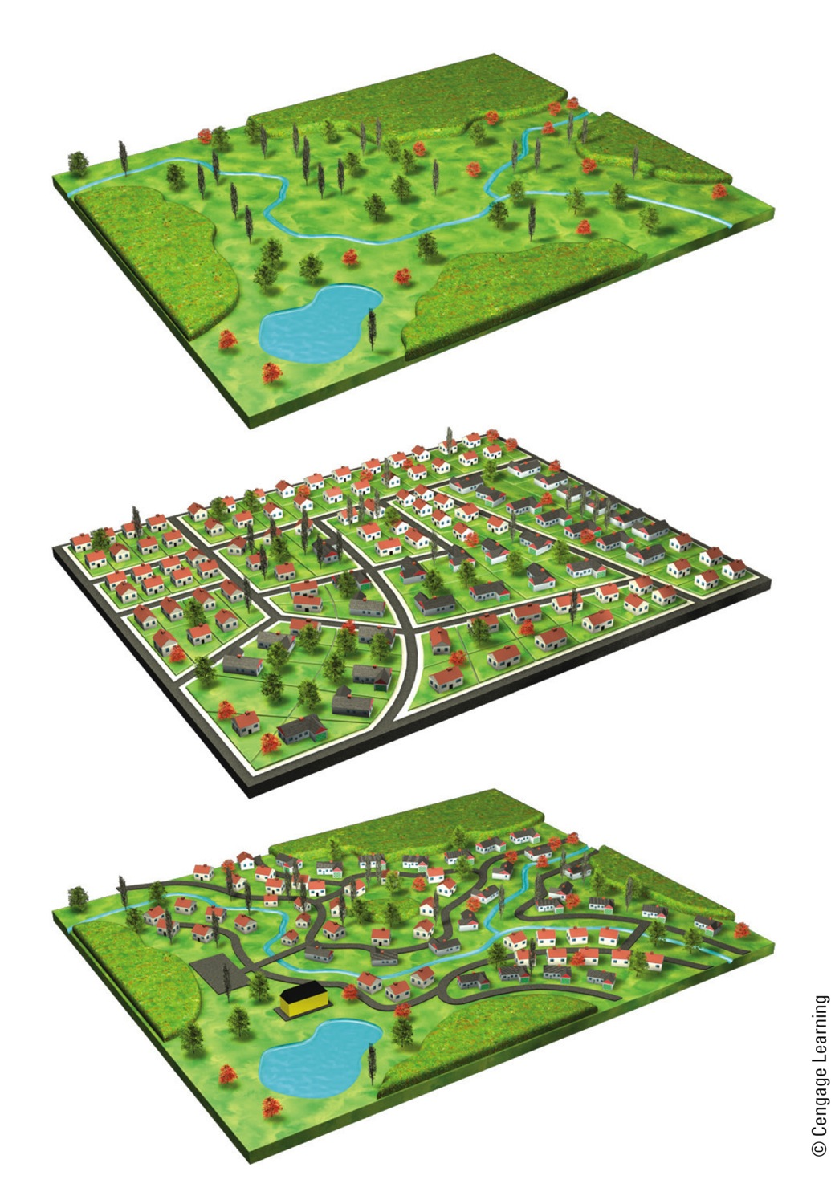
Undeveloped land
Creek
Marsh
Typical housing development
Cluster
Cluster housing development
Creek
Pond
Cluster
Fig. 22-23, p. 622
Notes:
Figure 22-23: These models compare a conventional housing development (center) with a cluster housing development (bottom). Question: What are the comparative effects of each type of development on the undeveloped land (top)?

Slide 36
Case Study: The Eco-City Concept in Curitiba, Brazil
Ecological capital of Brazil
Superb bus rapid-transit system
72% of the cities commuters
Cars banned for 49 blocks in the center of the city
Recycling programs
Care for the poor
https://www.youtube.com/watch?v=lUBgwIW6O2U

Slide 37
The Eco-Village Movement Is Growing
Eco-village movement
Design and live in more sustainable villages in rural and suburban areas
1993 – eco-village in Los Angeles, CA, U.S.
2011 – more than 380 eco-villages throughout the world

Slide 38
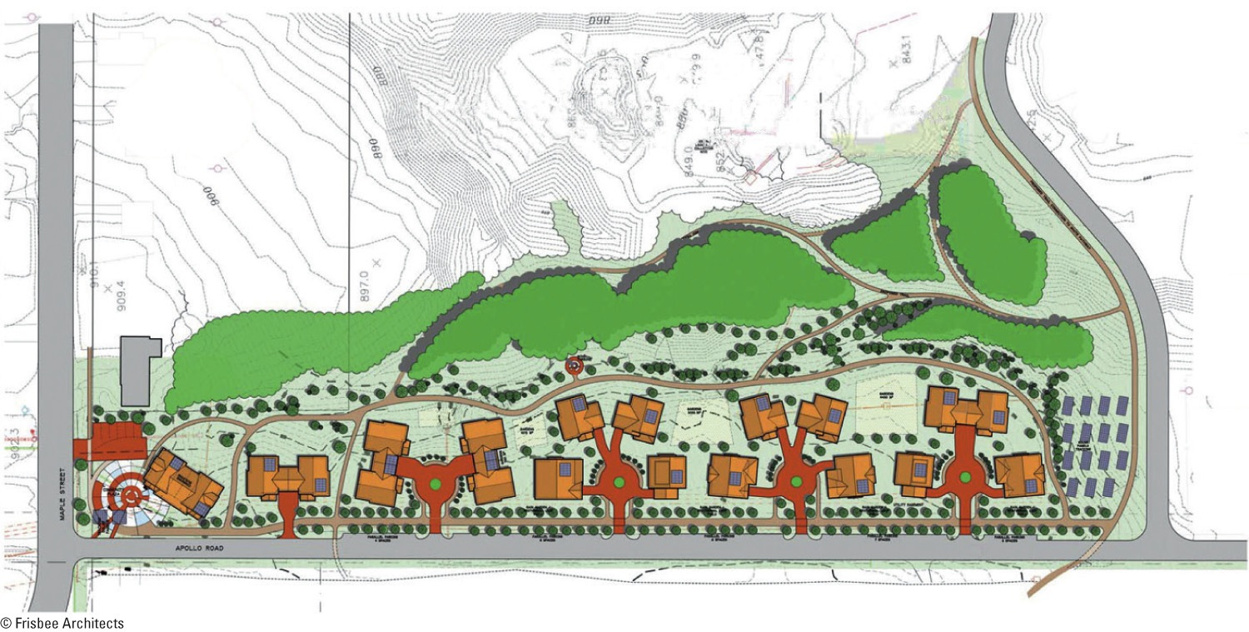
Fig. 22-26, p. 626
Notes:
Figure 22-26: The Eco-Village plan includes a community center (left end of map), 18 LEED platinum, energy-efficient homes, and a field of photovoltaic solar collectors (right end of map) that will provide most if not all of the village’s electrical needs. Some of the homes share a wall, which helps to make them energy efficient. Question: Can you think of any disadvantages to living in such a community? Do you think they would outweigh the advantages? Explain.

Slide 39
Three Big Ideas
Urbanization is increasing steadily and the numbers and sizes of urban areas are growing rapidly, especially in less-developed countries
Most urban areas are unsustainable with their large and growing ecological footprints and high levels of poverty

Slide 40
Three Big Ideas (cont’d.)
Urban areas can be made more sustainable and livable just as some cities and villages already are

Slide 41
What is the impact of Urbanization on
Biodiversity
Inequality of Water
Air Pollution
Diseases
Elevated emissions of air pollutants and GHGs
Development of slums?

