Slide 1
Top Environmental News Stories
Can you answer FRQs about these topics?

Slide 2
Older / Recurring Events

Slide 3
Hurricane Katrina
As Katrina made landfall, its front-right quadrant, which held the strongest winds, slammed into Gulfport and Biloxi, Mississippi, devastating both cities. A large storm surge ranging from 10 to 28 feet devastated coastal areas across southeastern Louisiana and coastal Mississippi.
The surge and battering waves smashed into levees, which collapsed, causing extensive flooding throughout the New Orleans region. Ultimately, 80 percent of New Orleans and large portions of nearby parishes became flooded, and the floodwaters did not recede for weeks.
The National Guard was called in to help with evacuations. Thousands sought refuge in the New Orleans Convention Center and the Superdome, which were overwhelmed. It was one of the largest displacements of a population since the Great Depression, according to the NOAA. According to The Data Center, an independent research organization in New Orleans, the storm displaced more than 1 million people in the Gulf Coast region.
[Infographic: Hurricane Katrina History and Numbers]

Slide 4
White-Nose Syndrome (WNS)
White-nose syndrome (WNS) is an emergent disease of hibernating bats that has spread from the northeastern to the central United States at an alarming rate. Since the winter of 2007-2008, millions of insect-eating bats in 25 states and five Canadian provinces have died from this devastating disease. (see map below) The disease is named for the white fungus,Pseudogymnoascus destructans, that infects skin of the muzzle, ears, and wings of hibernating bats. In April 2014, WNS was confirmed in Michiganand Wisconsin.

Slide 5
Consequences of Climate Change
Environmental Consequences
Receding polar ice caps
Melting of permafrost
Changes atmospheric energy balance – why?
Sea level rise (although due primarily to thermal expansion)
Messes up transportation routes
Releases methane – potent greenhouse gas
Altered climates in various places around the globe
Effect

Slide 6
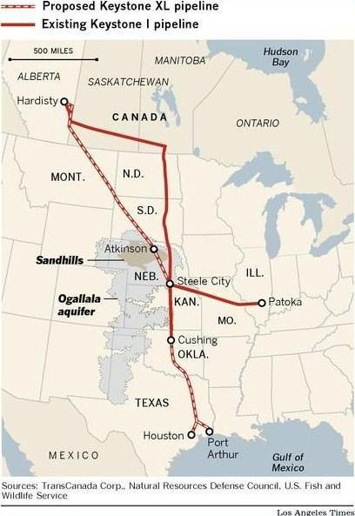
Keystone Pipeline
Transports unrefined oil from oil sands in Canada (largest producer) to refineries in SE United States
Replaces older pipeline
Allows for higher capacity of oil transport
Possible water contamination – part goes over the Ogallala Aquifer
Habitat degradation issues – goes through sensitive sandhill ecosystem in Nebraska
Less incentive to develop sustainable energy

Slide 7
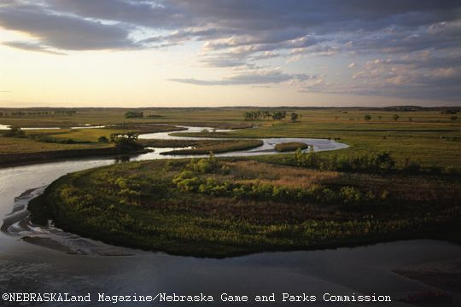
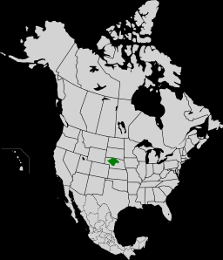
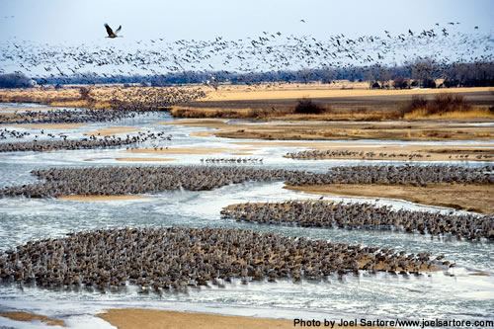
Sandhills, Nebraska

Slide 8
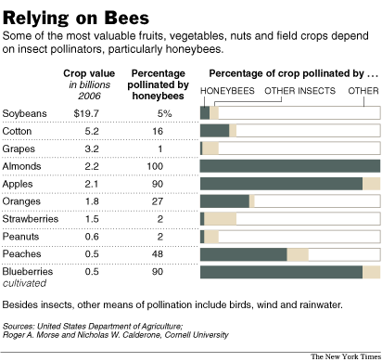
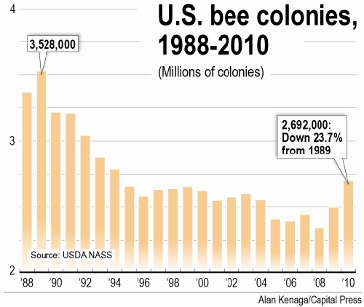
Bee Colony Collapse

Slide 9
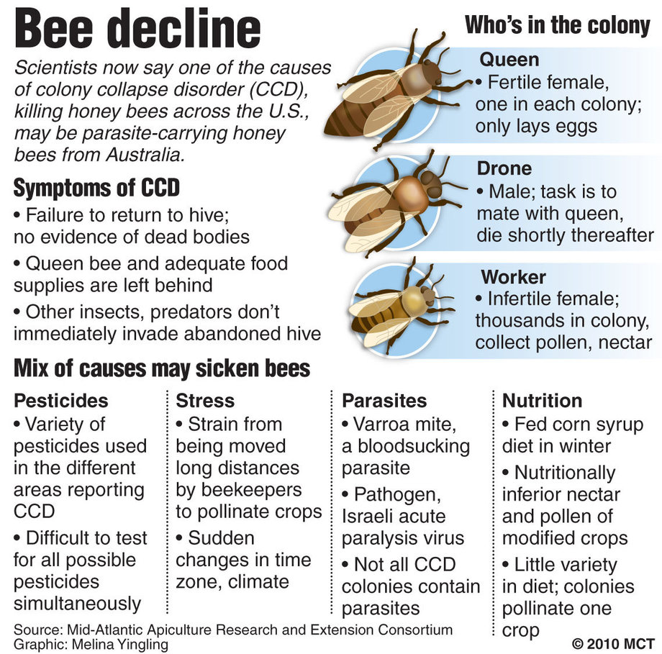
Bee Colony Collapse

Slide 10
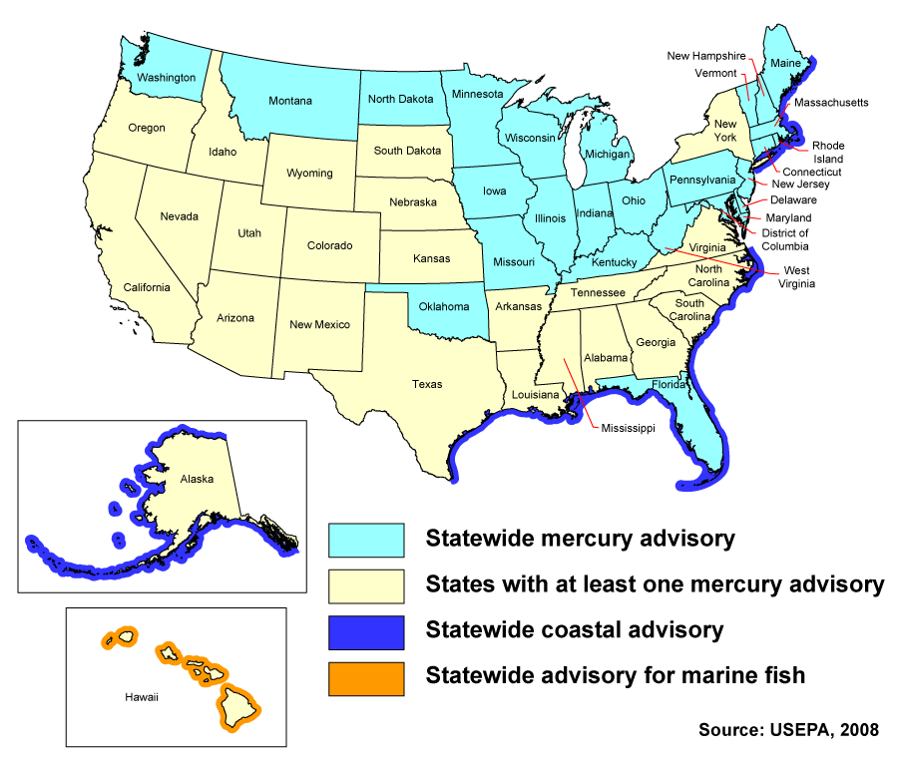
Mercury in Fish

Slide 11
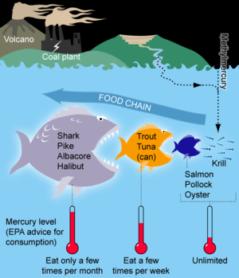
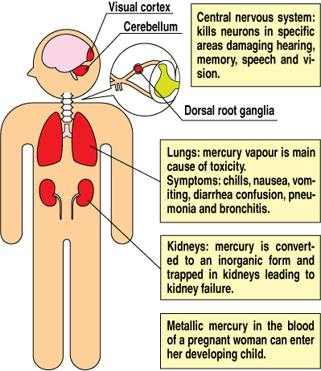
Mercury in Fish

Slide 12
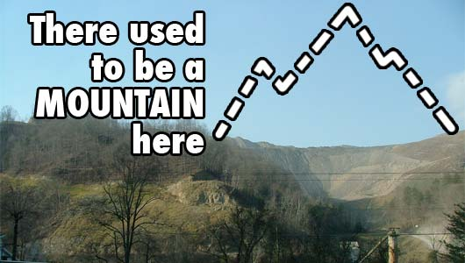
Mountain Top Removal

Slide 13
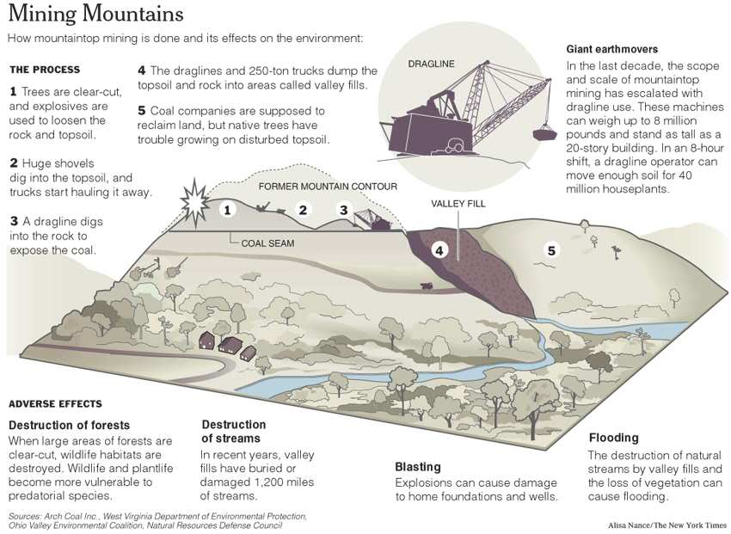

Slide 14
Human Population
I = P x A x T
  I = Impact; P = Population; A = Affluence; T = Technology
Rate of change = [b-d] + [i-e]
US population = 300 million
World population = 7 billion
Rule of 70 = 70/growth rate = number of years population will double
Total Fertility vs. Replacement Level Fertility
  Total Fertility = ave # children per woman
  RLF = ave # children per woman needed for zero population growth
Strategies to reduce population growth?
  Educate/empower women
  Decrease poverty
  Access to family planning

Slide 15
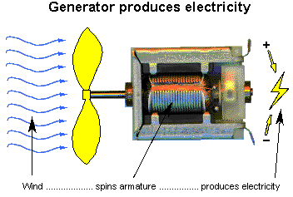
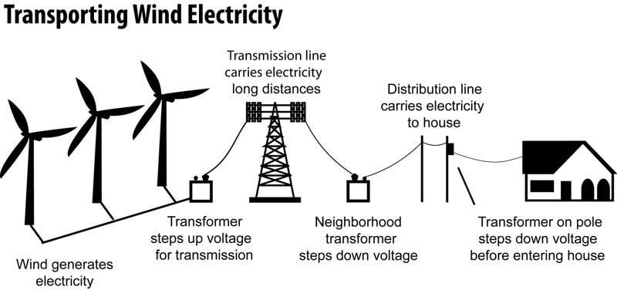
Wind Power
Wind spins turbine
Generator produces electricity
Electricity moves through transmission lines
Fastest growing renewable (though solar is close)
Risk to birds – collide with blades (significant, but more deaths attributed to collisions with buildings, predation by house cats, etc.)
Risk to bats –
decreased pressure
around blades causes
capillaries in lungs to
rupture
Possible math question?

Slide 16
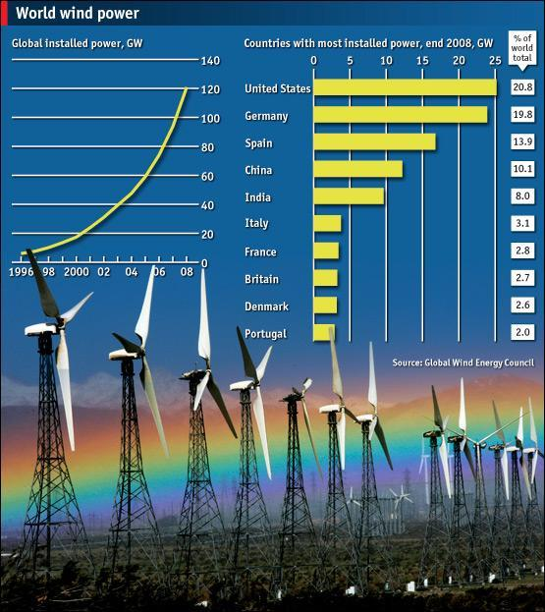

Slide 17
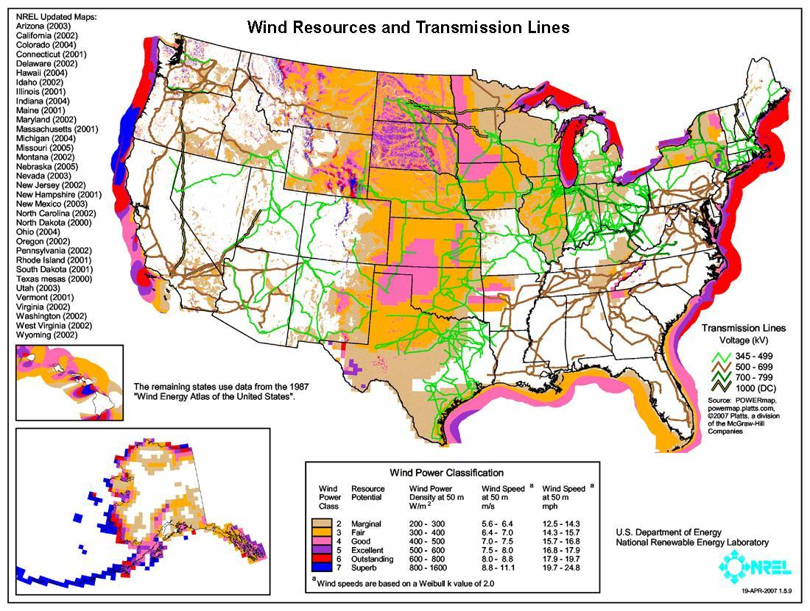

Slide 18
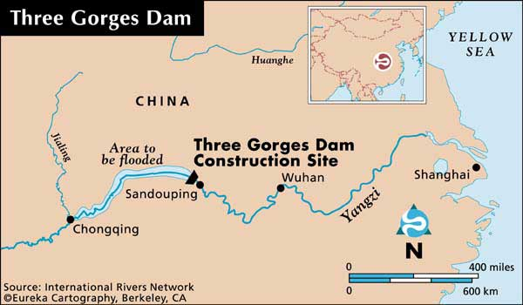
Dams/Rivers
Three Gorges Dam – Yangzi River in China
World’s largest hydropower project
Displaced 1.2 million people
Reservoir is polluted from submerged factories, mines, dumps
Erosion on banks of reservoir causing landslides
Worsens drought downstream
BUT… provides “clean”
energy, reliable water
source

Slide 19
Growing Production of Biofuels
Biofuels – most often ethanol from corn or sugarcane
Biofuels highly regionalized--in India, rice hulls
Uses lots of water, fertilizers, pesticides
Fertilizers associated with eutrophication and “dead zone” in Gulf of Mexico
Fertilizer runoff with phosphates and nitrates
Causes algal blooms – shades water plants below
Algae eventually dies
Bacteria decompose dead algae – uses dissolved oxygen
Fish and other animals die
Better alternative: Switchgrass and Algae

Slide 20
Plastic Bag Ban or Water Bottle Ban
Problems:
persistence of plastic in landfill
energy cost and oil dependence in producing bags
2 liters of oil for every one liter bottle
nonrecyclable plastic bags (bottles are recyclable
Solution:
  reusable alternatives are pretty simple
  ban or charge? (pricing structure)
  how much of a deposit would change your behavior?
  fake fields, diapers, other products can be made from recycled bottles

Slide 21
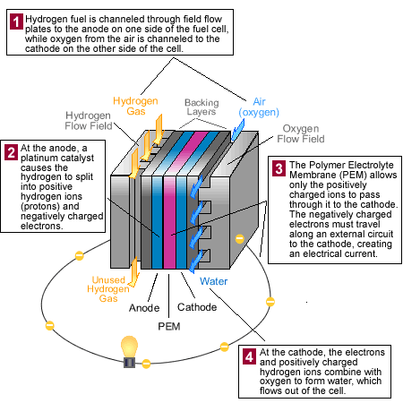
Hydrogen Fuel Cells

Slide 22
Hydrogen Fuel
Cons
2H2 + O2 → 2H2O
No emissions
Silent
No recharging
Can use renewable fuels to pull H2 from water - electrolysis
Fuel itself is efficient
Expensive – materials, R&D
Need H2 – takes energy to extract (often fossil fuels used!) – reduces overall efficiency
Often pulled from CH4 - Steam reforming (releases greenhouse gases)
Low density – hard to transport
Very flammable, no smell
Pros

Slide 23
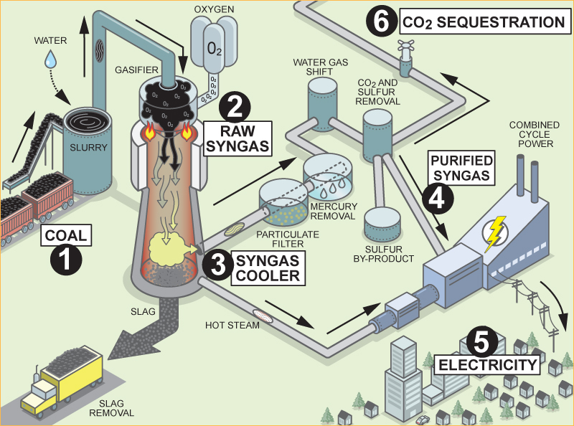
“Clean” Coal

Slide 24
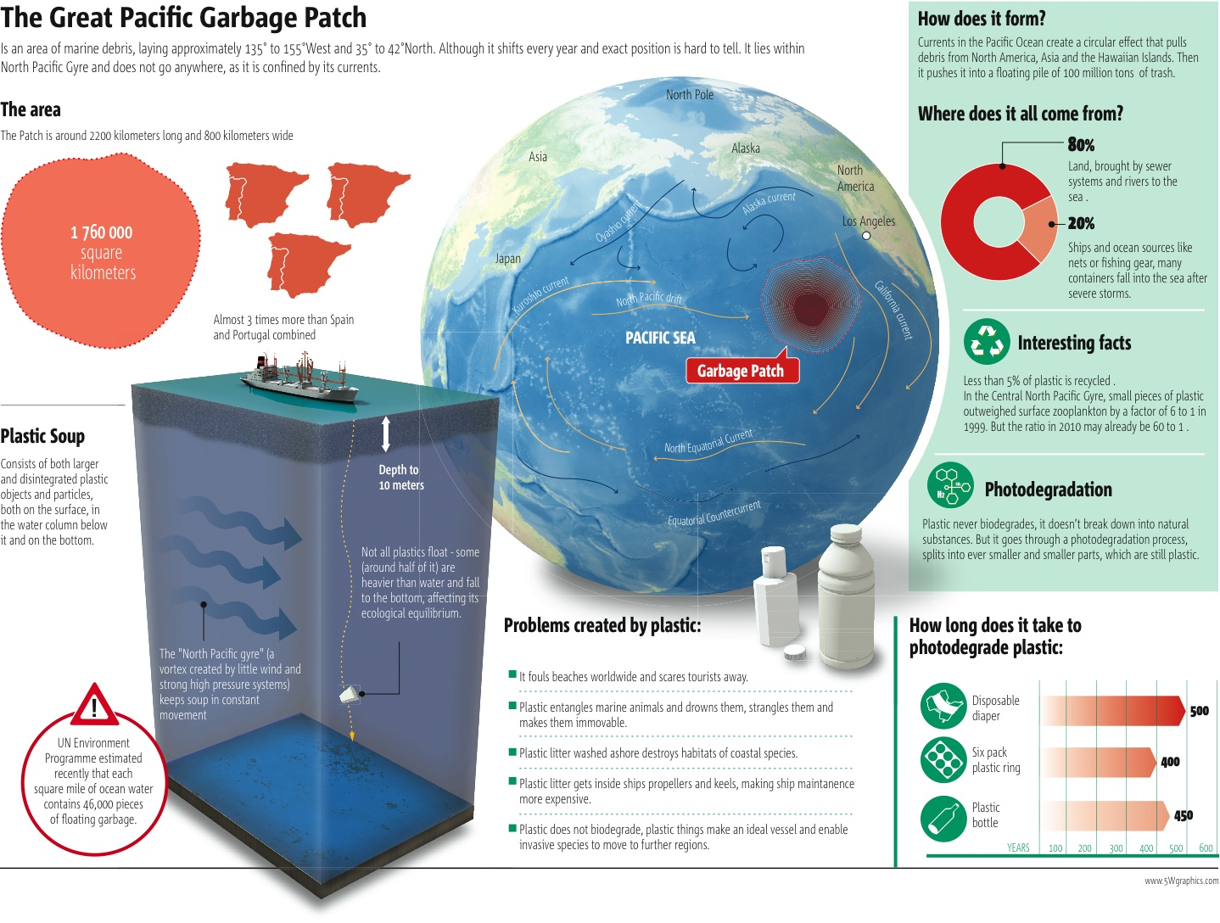

Slide 25
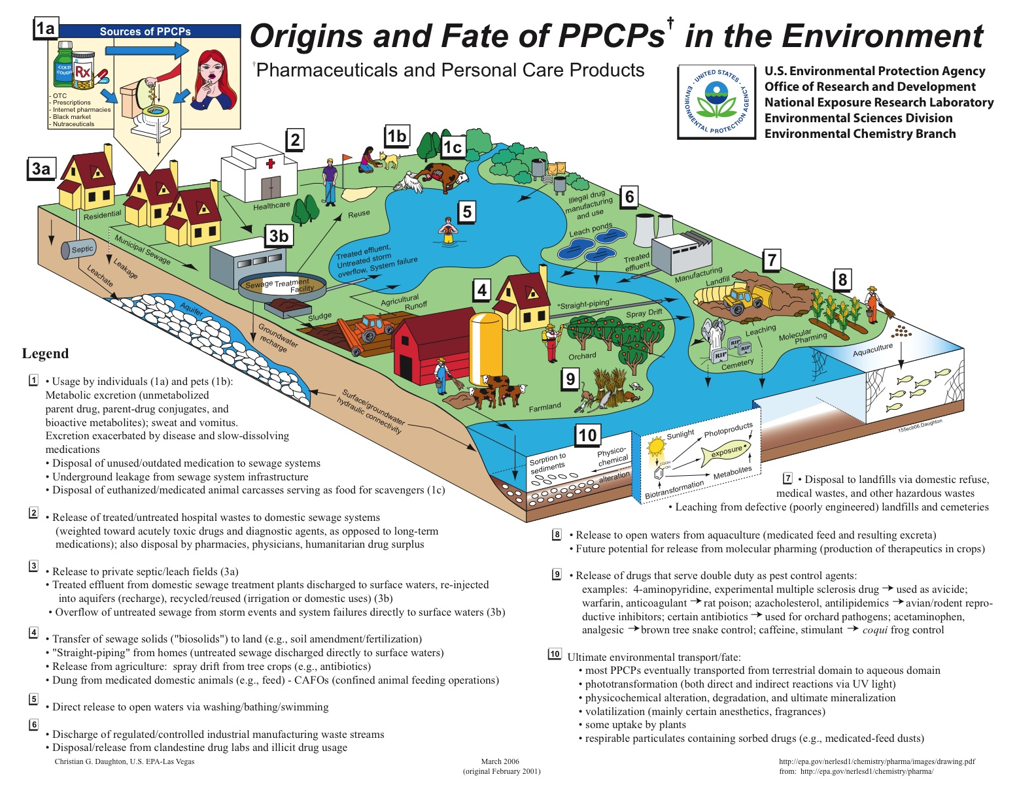

Slide 26
2010

Slide 27
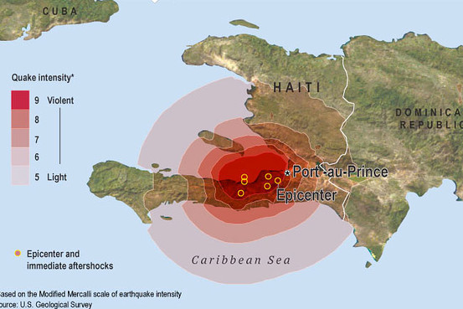
Haiti Earthquake - 2010
3 million people
affected
>200,000 killed
Magnitude 7.0
Transform Fault
Boundary
Why so bad?
  Focus’s shallow depth
  Highly populous area
  Extremely poor country – not well prepared
  Basic infrastructure (communication, transportation, water supply) severely damaged
  Spread of disease – cholera outbreak

Slide 28
Tainted eggs prompt food safety crisis, new law
Ongoing salmonella outbreak prompts egg recall.
As egg producers consolidate, problems of just one producer can be far-reaching.
Egg crisis piques interest in food-safety bill.
Unsafe eggs linked to U.S. failure to act.
Connects to industrial agriculture, human health and toxicology, antibiotic resistance
Samuel M. Livingston/flickr

Slide 29
The FDA takes on BPA; new evidence of widespread exposures.
FDA shifts stance on BPA, announces “some concern” about children’s health.
A new reason to worry. The Food Safety Modernization Act, if it survives the political process, would strengthen the FDA and hold food producers to higher safety standards. But while it would go a long way toward dealing with pathogens in our food supply, the bill largely ignores a different type of food-safety worry: hazardous man-made chemicals. Newsweek. 16 December 2010.

Slide 30
EPA takes a closer look at herbicide
Atrazine getting new scrutiny from EPA.
Study: Herbicide upsetting some animals' hormone systems. A new study shows that male frogs exposed to the herbicide atrazine -- commonly found in U.S. rivers and streams -- can make a startling developmental U-turn, turning female so completely that they can mate with other males and lay viable eggs. Washington Post. 2 March 2010. [Registration Required]
Weighing safety of weed killer in drinking water, EPA relies heavily on industry-backed studies. Companies with a financial interest in atrazine, a weed-killer sometimes found in drinking water, paid for thousands of studies federal regulators are using to assess the herbicide’s health risks, EPA records show. Meanwhile, some independent studies documenting potentially harmful effects are not being considered. Huffington Post Investigative Fund. 8 July 2010.

Slide 31
Cadmium turns up in children’s products
US CPSC
Walmart pulls jewelry over cadmium. Walmart is pulling an entire line of Miley Cyrus-brand necklaces and bracelets from its shelves after tests performed for The Associated Press found the jewelry contained high levels of the toxic metal cadmium. Associated Press. 20 May 2010.
McDonald's offers cash in recall of Shrek glasses. McDonald’s is paying customers to return Shrek drinking glasses it has recalled because of concerns that cadmium used in the paint on the glasses could come off on children’s hands. New York Times. 9 June 2010. [Registration Required]
Tests show cadmium risk in kids’ cups. Consumers were originally told the recalled McDonald's Shrek glasses were being recalled out of an abundance of caution. But regulatory records show that government scientists had concluded that a 6-year-old could be exposed to hazardous levels of the carcinogen after touching one of the glasses eight times in a day.Chicago Tribune, Illinois. 8 October 2010.
Kids' jewelry shows high levels of toxic metal cadmium: Health Canada documents. Three in 10 pieces of children’s jewelry tested by Health Canada for cadmium in the past year were made of as much as 93 per cent of the highly toxic metal, internal government test results show. Postmedia News. 18 October 2010.
Regulators advise on cadmium in toys. Federal product-safety regulators, responding to concerns about cadmium in children's products, Tuesday told manufacturers they could develop their own safety standards for the substance, but also proposed testing that would be more rigorous than children's product makers say is necessary. Wall Street Journal. 20 October 2010. [Subscription Required]

Slide 32
Pakistan hit by biblical flood
Pakistan floods affecting 20 million; cholera outbreak feared. Pakistan on Saturday sharply increased its estimate of the number of people affected by this summer's catastrophic floods to 20 million, and the United Nations said that 6 million of those victims lack access to food, shelter and water. Washington Post. 16 August 2010. [Registration Required]
Flood disaster may require largest aid effort in modern history. One of the largest humanitarian relief efforts ever attempted is now mobilizing to help Pakistan cope with what its government and U.N. agencies are calling the worst natural disaster in modern memory. ClimateWire. 21 August 2010.
Ten million without shelter in Pakistan floods: UN. Pakistan's devastating floods have left 10 million people without shelter, the United Nations said Tuesday, as authorities rushed to bolster river defences to save two towns from catastrophe. Agence France-Presse. 8 September 2010.

Slide 33
West Virginia mine disaster kills 29, prompts investigations
Mine disaster calls attention to revolving door between industry, government. More than 200 former congressional staff members, federal regulators and lawmakers are employed by the mining industry as lobbyists, consultants or senior executives, including dozens who work for coal companies with the worst safety records in the nation, a Washington Post analysis shows. Washington Post. 18 April 2010. [Registration Required]
Mountaintop coal mining rules may send more miners underground. A U.S. Environmental Protection Agency crackdown on mountaintop mining in Appalachia may force coal producers to rely increasingly on underground sites such as the Massey Energy Co. mine where 29 workers were killed this month in West Virginia.Bloomberg News. 23 April 2010.
Massey under criminal inquiry. Federal agents are interviewing current and former Massey Energy employees as part of a sprawling criminal investigation into the April 5 explosion that killed 29 miners at the company's Upper Big Branch Mine in Raleigh County, according to sources familiar with the inquiry. Charleston Gazette, West Virginia. 2 May 2010.

Slide 34
Coal-fired power plants told to cut smog emissions
EPA proposes to cut power-plant emissions in 31 states. The Obama administration proposed new rules Tuesday that would require owners of coal-fired power plants to invest in technology to slash the smog-forming gases they send drifting across the Eastern U.S. Wall Street Journal. 7 July 2010. [Subscription Required]
EPA calls on power plants to save lungs, but plan is hazy. A federal plan to cut air pollution from power plants within two years and lower lung disease nationally could make Northeast Florida's electricity more expensive. The changes would reduce the amount of sulfur dioxide and nitrogen oxides released in many fossil-fuel-burning Florida plants. Jacksonville Times-Union. Florida. 19 July 2010.
Proposed air quality rule could improve health, stifle industry growth. Crossroads area residents may breathe easier come 2012, but a proposed rule to reduce smog transport from state to state could also stifle coal industry growth, a state air quality official said. Victoria Advocate, Texas. 6 August 2010.

Slide 35
EPA regulates carbon; court rejects Texas claim
EPA says it will press on with greenhouse gas regulation. The EPA announced a timetable on Thursday for issuing rules limiting greenhouse gas emissions from power plants and oil refineries, signaling a resolve to press ahead on such regulation even as it faces stiffening opposition in Congress. But it was vague on how stringent the rules would be and how deep a reduction in carbon dioxide emissions would result. New York Times. 24 December 2010. [Registration Required]
EPA taking over greenhouse gas permits in Texas. The Environmental Protection Agency announced Thursday that it is taking the unprecedented step of directly issuing air permits to industries in Texas, citing the state's unwillingness to comply with greenhouse gas regulations going into effect Jan. 2. Associated Press. 24 December 2010.
EPA to double down on climate. The Obama administration is expected to roll out a major greenhouse gas policy for power plants and refineries as soon as Wednesday, signaling it won’t back off its push to fight climate change in the face of mounting opposition on Capitol Hill. Politico. 22 December 2010.
Court blocks move by oil industry to delay EPA regulation of greenhouse gas emissions. A U.S. appellate court on Friday turned down a request from utilities, oil refiners and the state of Texas to effectively delay the regulation of greenhouse gas emissions by the Environmental Protection Agency. Washington Post. 11 December 2010. [Registration Required]

Slide 36
Bedbugs spread across US
liz.novack/flickr
Bedbug numbers swell. Bedbugs were once a distantly remembered nuisance, the stuff of children's rhymes and Depression-era tales of woe. But increasingly, the tiny pests have become nightmarish bedfellows for homeowners, apartment dwellers and travelers in the Baltimore area and across the country. Baltimore Sun, Maryland. 26 July 2010.
'The most difficult, challenging pest problem of our generation.' From New York to Los Angeles, and everywhere in between, bedbugs are spoiling sleep, vacations, and the bottom line of just about every business except pest control. Philadelphia Inquirer, Pennsylvania. 15 August 2010. [Registration Required]
Bedbugs aren't just back, they're spreading. Bedbugs are back. At first, they appeared in places that you might expect, in dense city centers like New York, where officials may seek a bed bug czar, and San Francisco, which is trying landlord-education programs. But now reports of bedbug infestations are showing up in homes and hotels from Ohio to Texas. All Things Considered, National Public Radio. 22 August 2010.
How to fight a scourge: Scenes from the bedbug summit. It's possible that bedbugs are simply the latest in a long string of public panics over epidemics that eventually proved to be manageable, from killer bees to bird flu. But that would not quite capture the grim mood of a big bedbug summit. Time Magazine. 25 September 2010.

Slide 37
2011

Slide 38
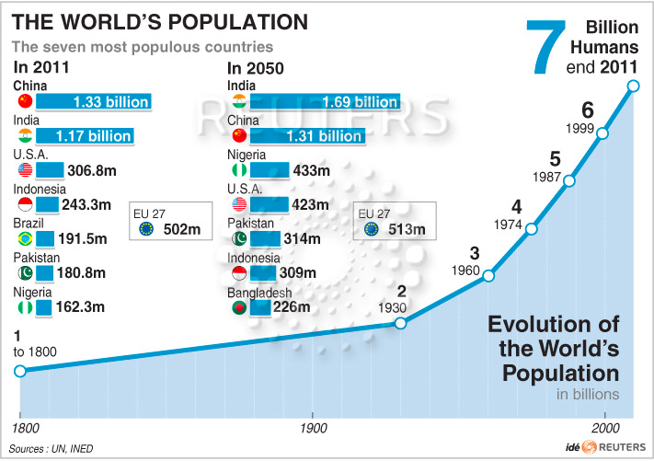
World Population Hits 7 Billion

Slide 39
BPA Banned
1. BPA Feels the Heat
Two months after trend-setting California banned the endocrine-disrupting chemical BPA in baby bottles and sippy cups (as of 2013), the federal Food and Drug Administration agreed under the pressure of a law suit to decide whether to eliminate BPA in all food packaging. Meanwhile, the American Chemistry Council, a trade group that has fought fiercely against the California bill and other legislative curbs on BPA, appeared to throw in the towel, at least part way, as it petitioned the U.S. Food and Drug Administration to "clarify for consumers" that it no longer uses the chemical in children's food containers.

Slide 40
Truth Will Out: Fracking Has Tainted Ground Water
Giving the lie to gas drillers' long-standing insistence that hydraulic fracturing to release shale oil and gas has never contaminated drinking water supplies, the Environmental Protection Agency announced that it had detected chemicals associated with fracking in groundwater in Wyoming. Earlier, EWG's own investigation uncovered a long-forgotten 1987 EPA report that found fracking-related contamination in water wells used by West Virginia residents. In the face of mounting public pressure, meanwhile,regulators decided to postpone action on rules that could open the door to widespread drilling and fracking in the vast Delaware River watershed.

Slide 41
Keystone XL Pipeline Decision
The Keystone XL pipeline, which may one day carry crude oil from Canada's oil sands to refineries along the U.S. Gulf Coast, has been contested since it began receiving attention earlier this year. After protests from environmentalists and activists, the Obama administration announced it would delay its decision on the pipeline. Over 1,200 people were arrested during a sit-in protest in front of the White House against the pipeline. The pipeline builder, TransCanada, reached an agreement with Nebraska in November to re-route the pipeline away from a major water source. Nebraska Governor Dave Heineman signed two bills in November that will affect the Keystone XL and any future oil pipelines in the state. One law allows the state to perform an environmental review of pipeline projects and the other "asserts Nebraska's authority over future oil pipeline projects,"reported the Associated Press. In mid-December, TransCanada's CEO expressed his fear that the Keystone XL has become tied to larger U.S. energy policy issues. Russ Girling said the pipeline's debate "has gone off on tangents." Meanwhile, HuffPost's Tom Zeller reported on the pipeline's fuzzy math and "persistent illusion of jobs, jobs and more jobs."

Slide 42
East Coast Hurricane And Earthquake
In late August, a 5.8 magnitude earthquake struck in Virginia, rattling the nation's capital. It was also felt in New York City. The Washington Monument and the Washington National Cathedral both sustained damage in the quake. Within a week, Hurricane Irene hit the East Coast of the U.S. Although the hurricane made landfall near New York City, the damage there was much less than expected. Unfortunately, damage was much more severe in Upstate New York and Vermont. The cost of the damage in Vermont alone has been estimated to be as much as $100 million.

Slide 43
Texas Drought
Throughout 2011, Texas experienced its single-worst drought since record keeping began, with an average of 12 inches of rain falling across the state since January. Thedrought has also impacted the cattle industry. 600,000 cows, or 12 percent of the state's population, have been moved or slaughtered since January. Interestingly, low water levels and receding lakes have revealed previously-hidden ghost towns, fossils and graves.

Slide 44
2012

Slide 45
Shell Arctic Drilling
Shell's exploratory drilling in the Arcticsparked anger this year among concerned locals and environmentalists. According to the Associated Press, Shell finished preliminary drilling at a well in the Chukchi Sea and one in the Beaufort Sea. In this July 14 photo, a Shell drilling ship drifts near the Alaska coast, raising questions about the company's preparedness. Greenpeace and The Yes Lab launched a hoax campaign to challenge Shell's drilling plans, and Paul McCartney argued, "As the ice retreats, the oil giants are moving in. Instead of seeing the melting as a grave warning to humanity, they're eyeing the previously inaccessible oil beneath the seabed at the top of the world. They're exploiting the disappearance of the ice to drill for the very same fuel that caused the melting in the first place."

Slide 46
Superstorm Sandy
Hurricane Sandy made landfall in Jamaica on Wednesday, October 24, 2012. The storm turned deadly in the Caribbean, and a hurricane/winter storm hybrid decimated regions along the U.S. East Coast. In the storm's aftermath, HuffPost found that some of Sandy's damage was the result of poor coastal development plans and emergency preparedness failures.

Slide 47
Arctic Ice Melt
Arctic sea ice levels hit record lows this September, the ice extent covering 49 percent below the 1979 average, when satellite records began. Scientists continued to emphasize the role that humans play in these changes. "It's crystal clear. If we burn all the fossil fuels, we create certain disaster," NASA scientist James Hansen warned.

Slide 48
Keystone Battle Continues in 2012

Slide 49
The battle on Fracking continues

Slide 50
BPA controversy continues

Slide 51
SeaWorld Lawsuits
SeaWorld was in the spotlight this year as video emerged of a 2006 "near death" incident between a trainer and a SeaWorld orca. The footage was shown at a trial on the death of trainer Dawn Brancheau. SeaWorld was also accused by PETA of violating the 13th Amendment on slavery. PETA complaining that the whales "were forcibly taken from their families and natural habitats, are held captive at SeaWorld San Diego and SeaWorld Orlando, denied everything that is natural to them, subjected to artificial insemination or sperm collection to breed performers for Defendants' shows, and forced to perform, all for Defendants' profit." The historic case was later dismissed by a federal judge.
Also- exotic captive animals released and killed.
Successful captive breeding programs

Slide 52
West Nile Outbreak
The U.S. experienced one of its worst West Nile virus outbreaks ever, thanks in part to weather conditions. The aerial spraying of pesticides to battle disease-carrying mosquitoes faced opposition from some residents and scientists who argued it's ineffective and potentially dangerous. As one concerned activist told HuffPost's Lynne Peeples, "How many times have they told us something was safe and then 10 years later it comes out that it's not safe?"

Slide 53
Extreme Weather
The U.S. suffered through a severe heat wave, the worst drought since 1988, and a raging wildfire season. Outside of the U.S., other nations also experienced extreme weather, and the Philippines was recently hit by Typhoon Bopha, which killed over 1,000 people. Many researchers are connecting the dots between some extreme weather trends and climate change. This year, NASA scientist James Hansen blamed three past heat waves on climate change, warning, "There is still time to act and avoid a worsening climate, but we are wasting precious time."

Slide 54
Drowning Nations
Some low-lying countries and coastal cities grew increasingly concerned this year as projections suggested sea levels could rise, largely due to climate change, up to three feet by the year 2100. Former Maldives President Mohamed Nasheed expressed concern about his country, which could be uninhabitable by 2100, in his new documentary, "The Island President." He warned in a HuffPost interview, “What happens to the Maldivestoday is going to happen to everyone else tomorrow.”

Slide 55
2013

Slide 56
Mayflower, Arkansas
March 29, 2013
Oil covers the ground around a slide in a neighborhood in Mayflower, Ark. days after a pipeline ruptured and spewed oil over lawns and roadways. Thousands of barrels spewed from the ruptured Pegasus pipeline, owned by ExxonMobil, forcing some residents to evacuate for months. (AP Photo/Jeannie Nuss)
Adds fuel to Keystone Pipeline Debate

Slide 57
California Drought Continues

Slide 58
More Extreme Weather, Tornadoes
El Reno, Oklahoma, June 1, 2013
Charlene Wilford helps load up items saved from a home damaged after a tornado hit El Reno, Okla. The tornado was the widest ever in recorded history, stretching to a width of 2.6 miles. It ripped through the area on May 31, 2013 killing at least nine people, injuring many others and destroying homes and buildings.
Moore, Oklahoma, June 2, 2013
An American flag flies from a car that sits in the driveway of a home that was damaged by a tornado in Moore, Okla. The devastating EF-5 tornado ripped through the town on May 20, killing 24 people, including 9 children, and destroying hundreds of homes and businesses. (Photo by Justin Sullivan/Getty Images)

Slide 59
Wildfires,
Firefighters work near a wildfire burning along a ridge in Yarnell, Ariz., in this photo provided by the U.S. Forest Service. The lightning-sparked fire spread to at least 2,000 acres amid triple-digit temperatures, and overtook an elite group of hotshot firefighters, killing 19 members as they tried to protect themselves from the flames under fire-resistant shields.
Rim Fire, Yosemite National Park, California, August 25, 2013
A firefighter watches for spot fires during a burnout operation while battling the Rim Fire near Yosemite National Park, Calif. The blaze, caused by a hunter’s illegal fire, destroyed more than 30,000 acres of forest and become the third-largest in state history.

Slide 60
Heatwaves
Southwest China’s Sichuan province during a heatwave that pushed thermometers as high as 106 degrees Fahrenheit. The deadly temperatures lasted for weeks, creating the worst heatwave in at least 140 years

Slide 61
Flooding
Boulder, Colorado Flooding, September 12, 2013
Sue Sadar walks across a trench of mud which used to be a lawn as she and family members clean property in an area inundated by flooding in Boulder County, Colo. A week of severe rains killed at least 8 people, destroyed more than 2,000 homes and caused upwards of $2 billion in damages.

Slide 62
Typhoons
Typhoon Haiyan, Tacloban, Philippines, November 2013
A Filipino man walks in a puddle of water at a neighborhood ravaged by Typhoon Haiyan in Tacloban. At least 6,000 people were killed by the storm, which was one of the strongest ever recoreded, and hundreds of thousands of people were displaced as it tore through the eastern Philippines on Nov. 8.

Slide 63
Atmospheric CO₂ Tops 400 PPM
Since 1958, the Mauna Loa Observatory on Hawai‘i’s Big Island has been keeping track of the amount of CO₂ in the atmosphere, and in May its readings crossed a worrisome threshold. For the first time in recorded history, the global concentration of carbon dioxide in the atmosphere is 400 parts per million. The last time Earth had such a high concentration of the heat-trapping gas was about four million years ago – and global temperatures then were 4 degrees Celsius higher than they are today, while global sea levels were between 5 and 40 meters higher. Scientists at Mauna Loa say we’re on track to hit 450 ppm of CO₂ within a few decades – far beyond the 350 ppm level that NASA climatologist James Hansen says is a safe number.

Slide 64
Important Vocab
Conservation
Preservation
Restoration
Remediation
Mitigation
Reclamation
Greatest good for greatest number?
Controlled use
Remaining wilderness areas of public land should be left untouched
Bring back to former condition
Associated with cleanup of chemical contaminants in a polluted area
Repairing/rehabilitating a damaged ecosystem or compensation for damage – substitute or replacement area (common with wetlands)
Chemical and physical manipulations in severely degraded sites like open pit mines

Slide 65
Final things to remember. . .
NOSCLP--criteria pollutants
Layers of atmosphere: TRy and STop ME THen. . .
CO2 is not a traditional air pollutant, its a GHG.
Fertilizers and pesticides are NOT the same. Fertilizers have N,P,K for plant growth. Pesticides kill bugs. Read about problems of each.
An ecological/ecosystem "cost" is NOT about money, its about a problem in an ecosystem. A question about $ will have the word "economic".
Stratospheric ozone thinning (hole) and global warming are NOT the same thing.
For air pollution questions, all pollutants except lead cause "respiratory problems such as asthma"
Advantage for any biome, ecosystem service, habitat = ecotourism, aesthetic value

Slide 66
Final things to remember. . .
Review experimental design: dependent & independent variables, hypothesis with "increasing/decreasing" in it.
Use the words "money" or "jobs" for economic questions. For govt. incentives: subsidies, tax credit/rebates, cap and trade. Disincentives include taxes, fines, legal penalties, property value loss
Eutrophication: excess nutrients (N,P) from fertilizer, manure or urban sewage are washed by rain into rivers which flow to the ocean => algal/phytoplankton bloom then die-off from lack of light => decomposed by bacteria who use all the oxygen => hypoxia and fish death => anaerobic mess
When talking about change in an ecosystem, use "increasing" or "decreasing". Ex: Invasive species cause native species population to decrease
Review the nitrogen cycle! The AP exam LOVES the nitrogen cycle.
If you can’t think of other possible solutions to problems, use education (but indicate what we should educate about).
Notes:
Review the nitrogen cycle! The AP exam LOVES the nitrogen cycle.

Slide 67
Final things to remember. . .
An ecosystem service is defined as something nature provides humans for survival or economic benefit. NOT something nature gives itself.
#1 way to control population growth is to provide education (literacy) for girls. Girls marry later, and have less children. Lowers poverty.
Try the Rule of 70 for growth rate.
Food chains always begin with a producer. Arrows point the direction of energy flow (toward the predator).
Anthropogenic = human made. Degradation = decline in quality. Synthetic = not natural.
Loss of biodiversity → HIPPCO
Sustainability = protect natural cycles + true pricing + renewable energy + biodiversity + population control

Slide 68
Important Laws
Coastal Management Act
Corporate Average Fuel Economy (CAFE standards)
Clean Air Act
Clean Water Act
Comprehensive Environmental Response, Compensation Liability Act (CERCLA)
Manages coastal resources (including Great Lakes) – balances economic development with conservation
Sets minimum fuel economy standards
Establishes primary and secondary air quality standards for 6 criteria pollutants (SO2, NOx, CO, PM, O3, Pb)
Regulates discharge into water sources and wetland destruction
Provides funds for clean-up of hazardous substances (Superfund Sites)

Slide 69
Important Laws
Convention on International Trade in Endangered Species (CITES)
Endangered Species Act (ESA)
Federal Insecticide, Fungicide, and Rodenticide Act (FIFRA)
Kyoto Protocol
International legislation banning hunting, selling, importing endangered species
Protects threatened and endangered species and their habitats – involves recovery plan
Requires that pesticides are registered and approved by the FDA
Agreement among 150 nations requiring greenhouse gas emissions reduction

Slide 70
Important Laws
Prohibits transportation of illegally captured/ prohibited animals across state lines – first federal law protecting wildlife; controls spread of non-native species
Governs marine fisheries management in US waters – sets catch limits, calls for increased international cooperation
Prohibits (with special exceptions) the take of marine mammals in US waters and by US citizens in the high seas
Lacey Act
Magnuson-Stevens Fishery Conservation and Management Act (MSRA)
Marine Mammals Protection Act

Slide 71
Important Laws
Montreal Protocol
National Environmental Policy Act (NEPA)
National Forest Management Act
Banned production of aerosols and initiated the phasing out of CFCs
Requires environmental impact statement for every major federal project
Sets standards for how the Forest Service manages National Forests – requires land management plans for national forests and grasslands

Slide 72
Important Laws
Resource Conservation and Recovery Act (RCRA)
Safe Drinking Water Act
Surface Mining Control and Reclamation Act
Toxic Substances Control Act
Management of solid waste including landfills and storage tanks – set minimum standards for all waste disposal (including hazardous waste)
Sets standards for drinking water quality
Requires restoration of abandoned mines
Tracks 75,000 industrial chemicals – tested for environmental or health hazard and banned if high risk

