Slide 1
Popular Stories that could be on FRQ
Updated 2019
By Kristin Shapiro, Plano East Senior High School, Plano Tx

Slide 2
Experimental Design
5 x 5 design
Emphasis on IV, control, and DV
Maintain constants
Null hypothesis also accepted

Slide 3
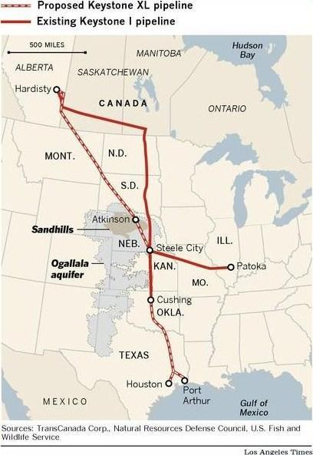
Keystone Pipeline
Transports unrefined oil from oil sands in Canada (largest producer) to refineries in SE United States
Replaces older pipeline
Allows for higher capacity of oil transport
Possible water contamination – part goes over the Ogallala Aquifer
Habitat degradation issues – goes through sensitive sandhill ecosystem in Nebraska
Less incentive to develop sustainable energy

Slide 4
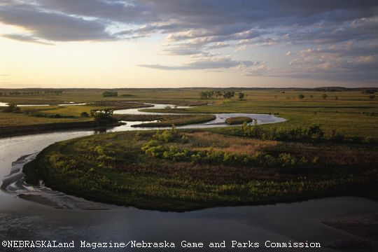
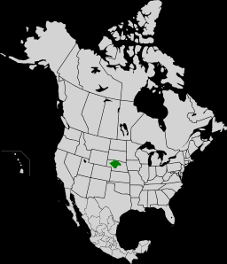
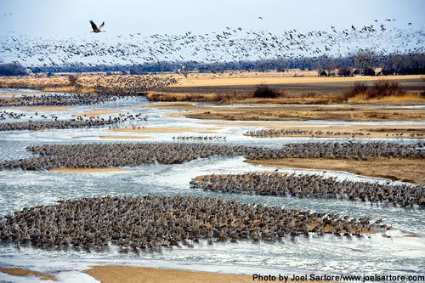
Sandhills, Nebraska

Slide 5
Keystone XL Pipeline Decision
The Keystone XL pipeline, which may one day carry crude oil from Canada's oil sands to refineries along the U.S. Gulf Coast, has been contested since it began receiving attention earlier this year. After protests from environmentalists and activists, the Obama administration announced it would delay its decision on the pipeline. Over 1,200 people were arrested during a sit-in protest in front of the White House against the pipeline. The pipeline builder, TransCanada, reached an agreement with Nebraska in November to re-route the pipeline away from a major water source. Nebraska Governor Dave Heineman signed two bills in November that will affect the Keystone XL and any future oil pipelines in the state. One law allows the state to perform an environmental review of pipeline projects and the other "asserts Nebraska's authority over future oil pipeline projects,"reported the Associated Press. In mid-December, TransCanada's CEO expressed his fear that the Keystone XL has become tied to larger U.S. energy policy issues. Russ Girling said the pipeline's debate "has gone off on tangents." Meanwhile, HuffPost's Tom Zeller reported on the pipeline's fuzzy math and "persistent illusion of jobs, jobs and more jobs."

Slide 6
Mayflower, Arkansas
March 29, 2013
Oil covers the ground around a slide in a neighborhood in Mayflower, Ark. days after a pipeline ruptured and spewed oil over lawns and roadways. Thousands of barrels spewed from the ruptured Pegasus pipeline, owned by ExxonMobil, forcing some residents to evacuate for months. (AP Photo/Jeannie Nuss)
Adds fuel to Keystone Pipeline Debate

Slide 7
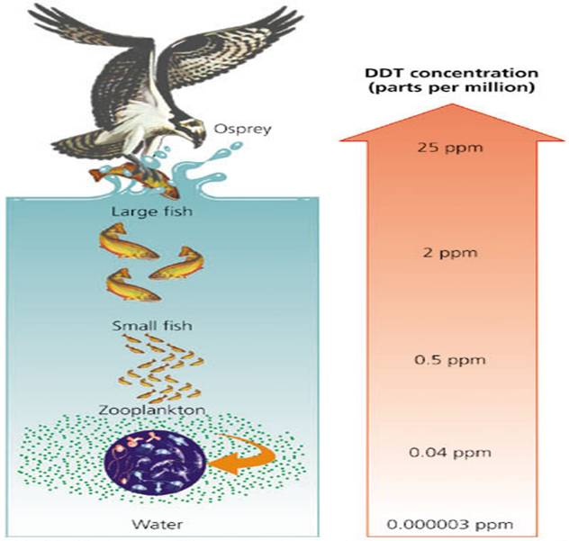
Mercury deposition
Hg in air from burning coal
Deposits into water
Bioaccumulates and biomagnifies in food web
Hg is a neurotoxin
What about deposition on land?
Bird songs

Slide 8
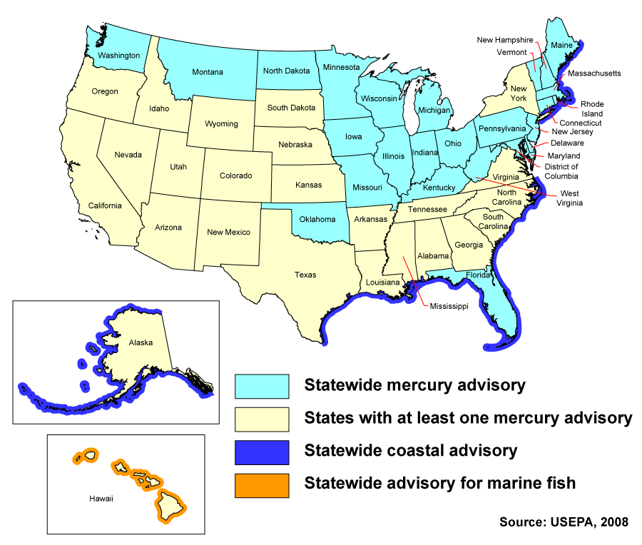
Mercury in Fish

Slide 9
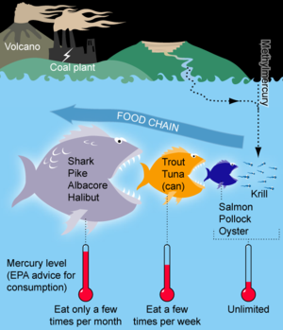
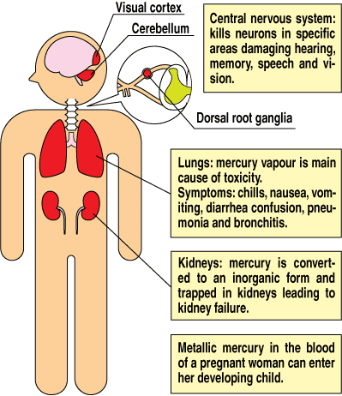
Mercury in Fish

Slide 10
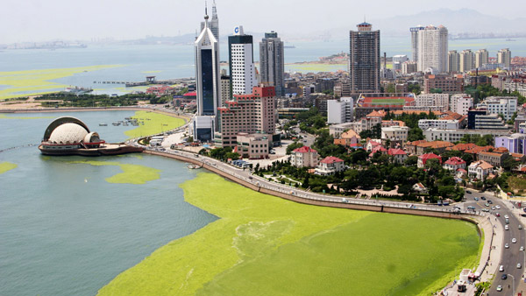
Algal blooms
Eutrophication/ cultural eutrophication/ nutrient loading
Causes – fertilizer runoff, sewage, animal waste, N, P
Chesapeake Bay, Gulf of Mexico, Mediterranean Sea

Slide 11
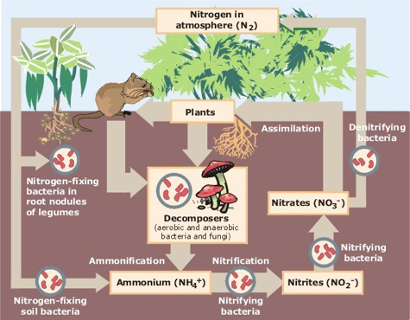
Nitrogen Cycle

Slide 12
Human Impact on Nitrogen Cycle
Excessive use runs off: remedied by riparian zones
Made up of NPK: Phosphorus is limiting in water, causes algal blooms
Oxygen sag curve results: hypoxic zones
Gulf of Mexico
Causes eutrophication/cultural eutrophication

Slide 13
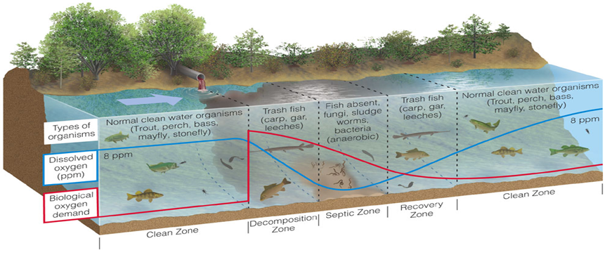
Oxygen Sag Curve

Slide 14
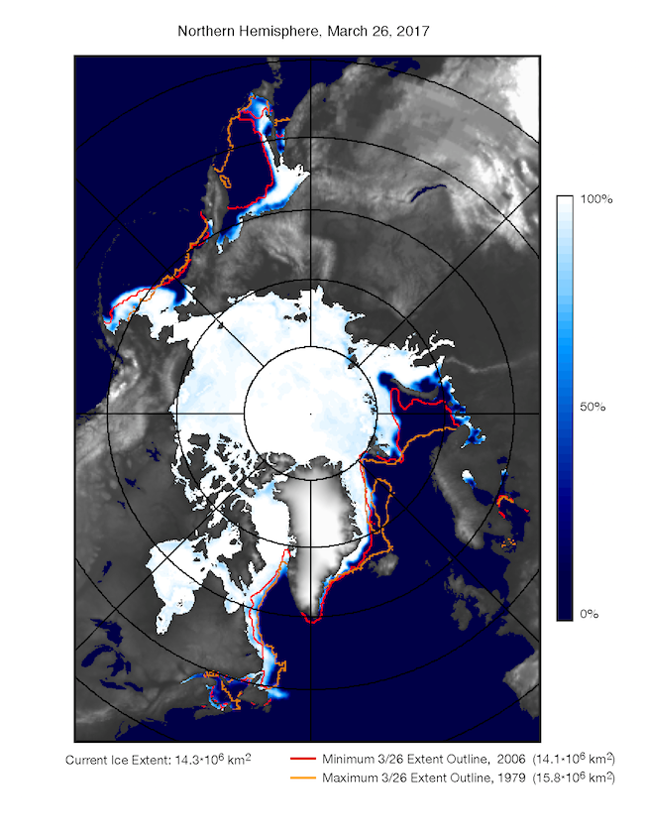
Declining Sea Ice
Sea ice is declining due to increasing temperatures
Major part of arctic ecosystems - causing loss of biodiversity
Greenland ice sheets heavily impacted
Less white ice means areas absorb more radiation, radiates back into the atmosphere, trapping more IR, causing increasing melting → positive feedback loop
Receding polar ice may also cause an increase in sea level rise (although due primarily to thermal expansion)

Slide 15
Shell Arctic Drilling
Shell's exploratory drilling in the Arctic sparked anger this year among concerned locals and environmentalists. According to the Associated Press, Shell finished preliminary drilling at a well in the Chukchi Sea and one in the Beaufort Sea. In this July 14 photo, a Shell drilling ship drifts near the Alaska coast, raising questions about the company's preparedness. Greenpeace and The Yes Lab launched a hoax campaign to challenge Shell's drilling plans, and Paul McCartney argued, "As the ice retreats, the oil giants are moving in. Instead of seeing the melting as a grave warning to humanity, they're eyeing the previously inaccessible oil beneath the seabed at the top of the world. They're exploiting the disappearance of the ice to drill for the very same fuel that caused the melting in the first place."

Slide 16
Arctic Ice Melt
Arctic sea ice levels hit record lows this September, the ice extent covering 49 percent below the 1979 average, when satellite records began. Scientists continued to emphasize the role that humans play in these changes. "It's crystal clear. If we burn all the fossil fuels, we create certain disaster," NASA scientist James Hansen warned.

Slide 17
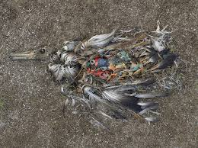
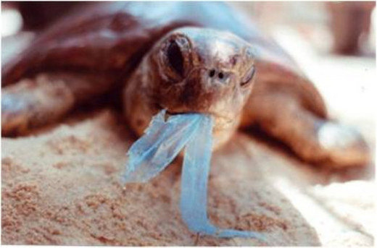
Possible FRQ topics
Pollution, water: The Great Pacific Garbage Patch
Mostly plastic
Between CA and China
PCBs, bisphenol A,
Photodegredation of plastics
More plastic than plankton
Tiny pieces ingested by zooplankton →bioaccumulation in the food chain
Plastic bag bans
Microplastics on 2017

Slide 18
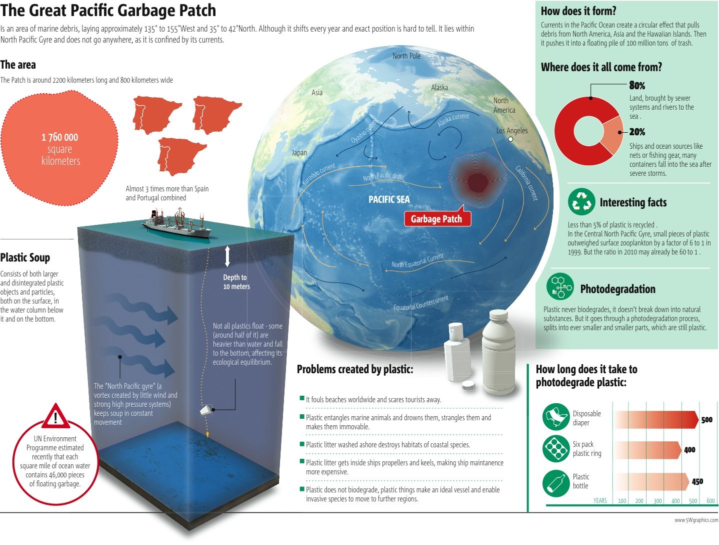

Slide 19
Plastic Bag Ban or Water Bottle Ban
Problems:
persistence of plastic in landfill
energy cost and oil dependence in producing bags
2 liters of oil for every one liter bottle
nonrecyclable plastic bags (bottles are recyclable
Solution:
reusable alternatives are pretty simple
ban or charge? (pricing structure)
how much of a deposit would change your behavior?
fake fields, diapers, other products can be made from recycled bottles

Slide 20
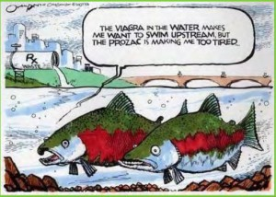
Prescription drugs in our surface water
“pharmapollution”
From pee and flushed meds
Sewage treatment plants not designed to remove drugs from water
What is the impact on wildlife? Human health?

Slide 21
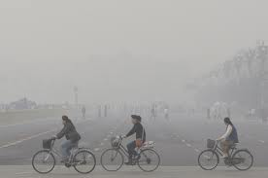
Photochemical Smog
Air – Smog
Gray, industrial smog
From burning coal
Sulfur, particulate matter
Worst in China
Affluence contributes
Links to demographic transition?
Brown, photochemical smog
From cars and heat
Ozone, VOCs
Worst in CA
Solutions?

Slide 22
Coal-fired power plants told to cut smog emissions
EPA proposes to cut power-plant emissions in 31 states. The Obama administration proposed new rules Tuesday that would require owners of coal-fired power plants to invest in technology to slash the smog-forming gases they send drifting across the Eastern U.S. Wall Street Journal. 7 July 2010. [Subscription Required]
EPA calls on power plants to save lungs, but plan is hazy. A federal plan to cut air pollution from power plants within two years and lower lung disease nationally could make Northeast Florida's electricity more expensive. The changes would reduce the amount of sulfur dioxide and nitrogen oxides released in many fossil-fuel-burning Florida plants. Jacksonville Times-Union. Florida. 19 July 2010.
Proposed air quality rule could improve health, stifle industry growth. Crossroads area residents may breathe easier come 2012, but a proposed rule to reduce smog transport from state to state could also stifle coal industry growth, a state air quality official said. Victoria Advocate, Texas. 6 August 2010.

Slide 23
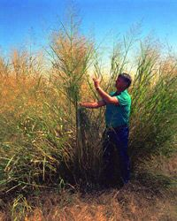
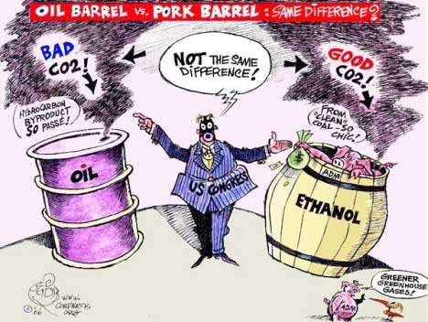
Biofuels
Usually ethanol from corn or sugarcane
Cellulosic – from forest and crop residues
Cellulose to ethanol
Palm oil
Uses LOTS of water, fertilizers, pesticides
Switchgrass and algae better alternatives

Slide 24
Growing Production of Biofuels
Biofuels – most often ethanol from corn or sugarcane
Biofuels highly regionalized--in India, rice hulls
Uses lots of water, fertilizers, pesticides
Fertilizers associated with eutrophication and “dead zone” in Gulf of Mexico
Fertilizer runoff with phosphates and nitrates → Causes algal blooms
Better alternative: Switchgrass and Algae

Slide 25
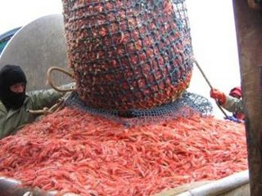
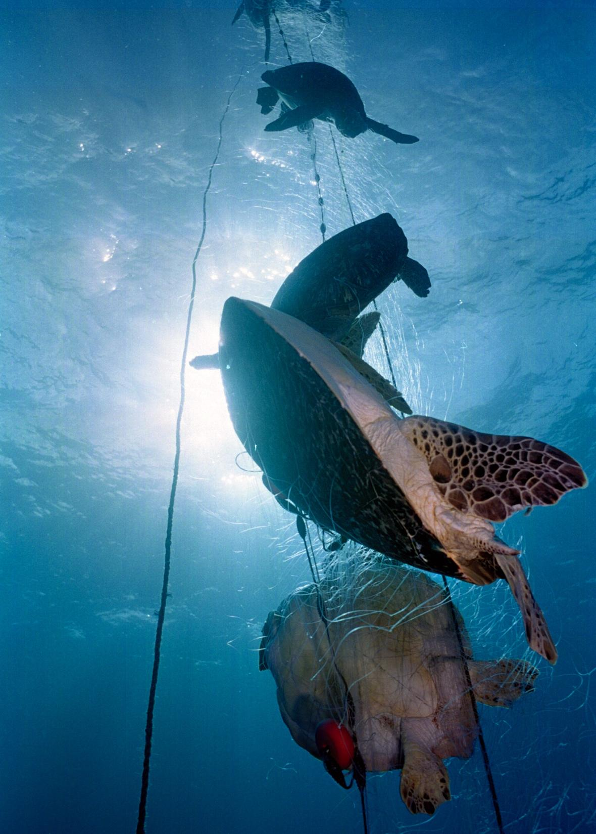
Overfishing
More people eating fish
Bycatch
CITES , Magnuson-Stevens Fisheries Act

Slide 26
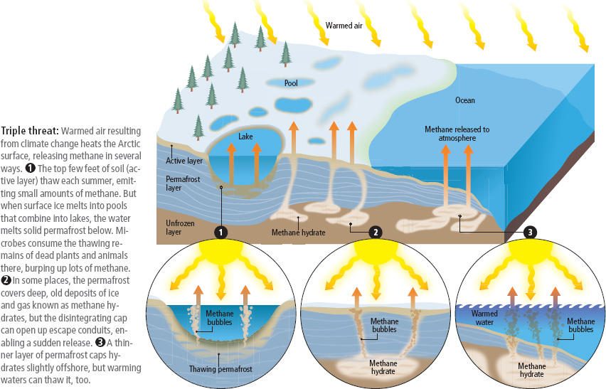
Permafrost
Melting permafrost due to climate change
Positive feedback loop
What is permafrost?
Tundra ecosystem
Releases methane – more powerful than CO2

Slide 27
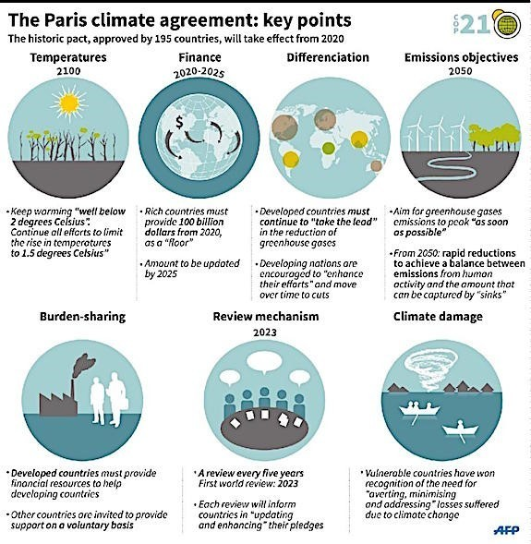
Paris Accord
Keep temps below 2ºC
Rich countries pay $100 billion
Developed countries take the lead
Decrees emissions and increase sinks
Review every 5 years
Take effect in 2020

Slide 28
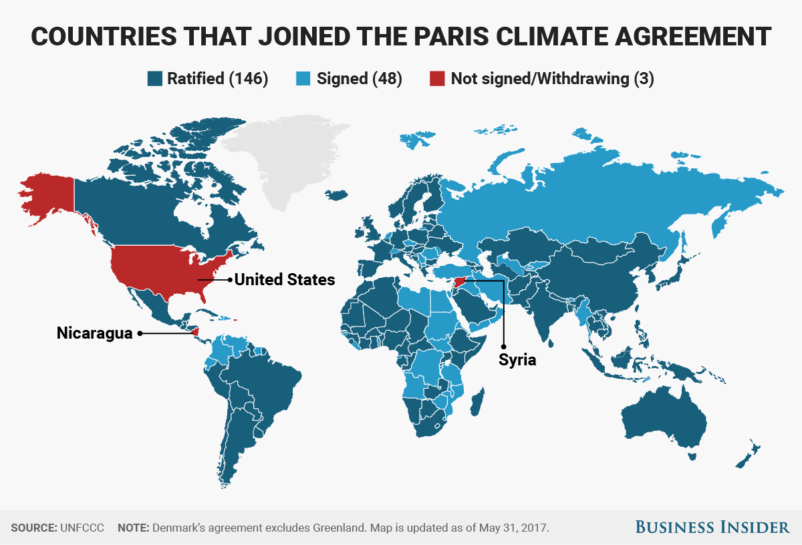

Slide 29
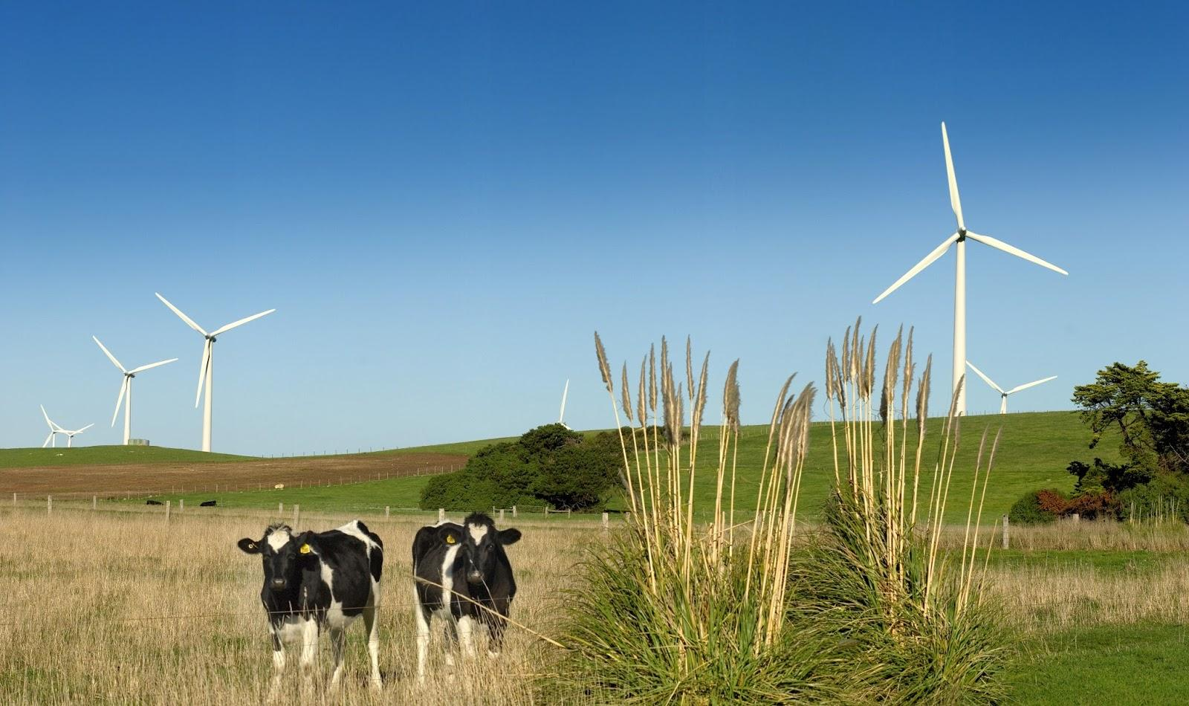
Wind power
Wind spins turbine to create electricity
Risks to birds and bats
Eyesores?
Offshore wind farms
Wind farms and ag can cohabitate

Slide 30
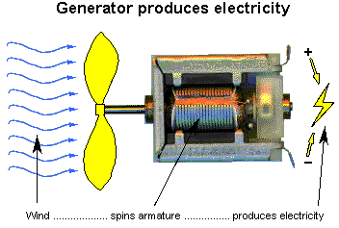
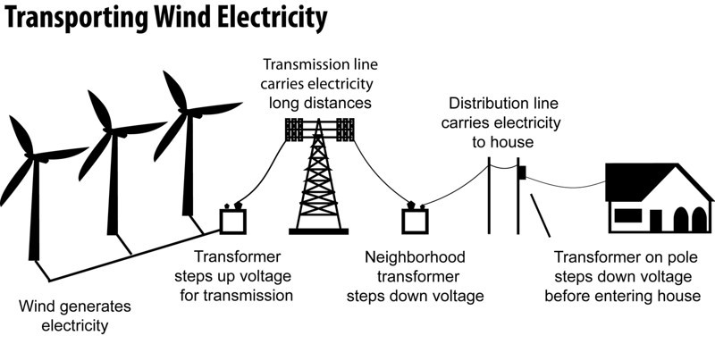
Wind Power
Wind spins turbine
Generator produces electricity
Electricity moves through transmission lines
Fastest growing renewable (though solar is close)
Risk to birds – collide with blades (significant, but more deaths attributed to collisions with buildings, predation by house cats, etc.)
Risk to bats – decreased pressure around blades causes capillaries in lungs to rupture
Possible math question?

Slide 31
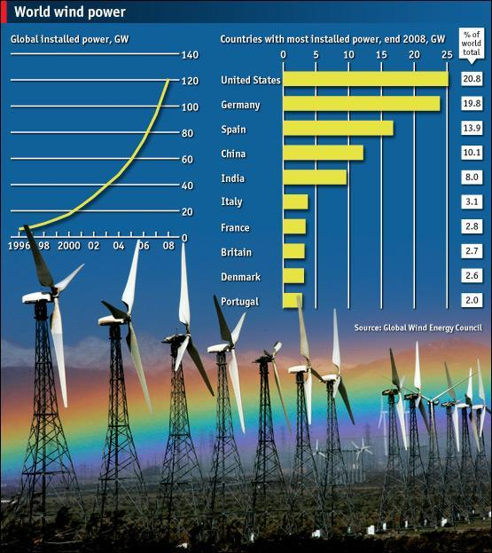

Slide 32
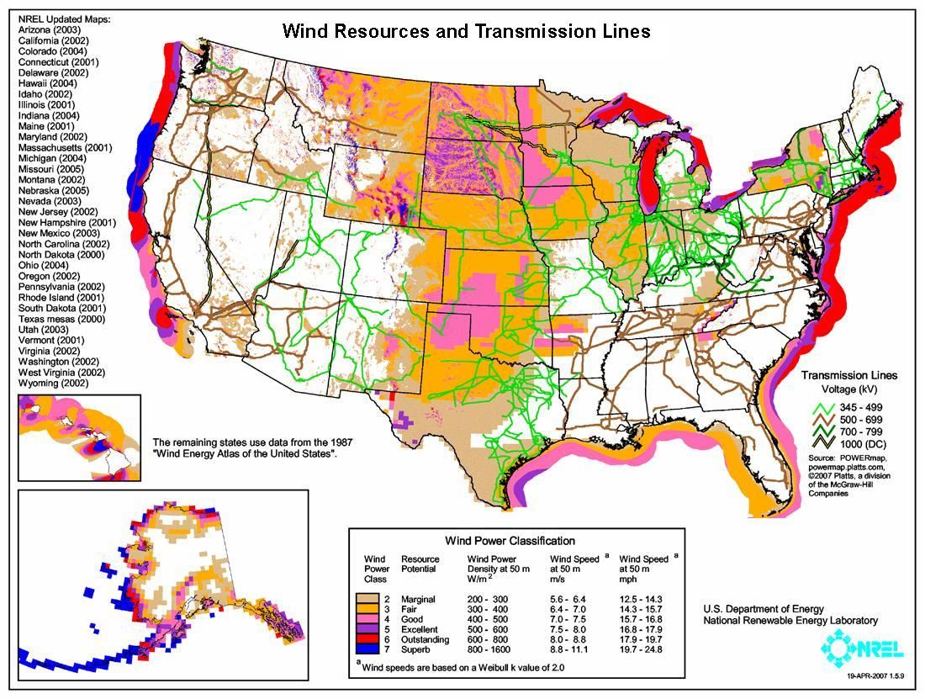

Slide 33
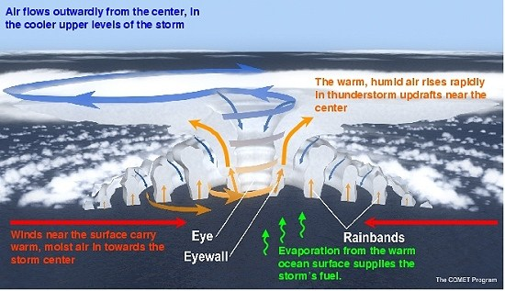
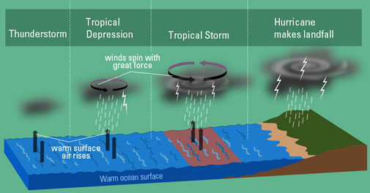
Hurricanes Coriolis Effect
Major hurricanes have been increasing in severity due to climate change
Sandy: New York; Katrina: Off coast of Mississippi and Louisiana
Katrina: Levees failed and major portions of region flooded, poorest hit regions caused massive environmental refugees
Ecological impacts included flooded terrestrial habitats, habitat destruction, barrier islands are made to protect coastal regions - we are doing major damage to these areas due to construction which also leads to erosion.

Slide 34
Extreme Weather
The U.S. suffered through a severe heat wave, the worst drought since 1988, and a raging wildfire season. Outside of the U.S., other nations also experienced extreme weather, and the Philippines was recently hit by Typhoon Bopha, which killed over 1,000 people. Many researchers are connecting the dots between some extreme weather trends and climate change. This year, NASA scientist James Hansen blamed three past heat waves on climate change, warning, "There is still time to act and avoid a worsening climate, but we are wasting precious time."

Slide 35
East Coast Hurricane And Earthquake
In late August, a 5.8 magnitude earthquake struck in Virginia, rattling the nation's capital. It was also felt in New York City. The Washington Monument and the Washington National Cathedral both sustained damage in the quake. Within a week, Hurricane Irene hit the East Coast of the U.S. Although the hurricane made landfall near New York City, the damage there was much less than expected. Unfortunately, damage was much more severe in Upstate New York and Vermont. The cost of the damage in Vermont alone has been estimated to be as much as $100 million.

Slide 36
Superstorm Sandy
Hurricane Sandy made landfall in Jamaica on Wednesday, October 24, 2012. The storm turned deadly in the Caribbean, and a hurricane/winter storm hybrid decimated regions along the U.S. East Coast. In the storm's aftermath, HuffPost found that some of Sandy's damage was the result of poor coastal development plans and emergency preparedness failures.

Slide 37
More Extreme Weather, Tornadoes
El Reno, Oklahoma, June 1, 2013
Charlene Wilford helps load up items saved from a home damaged after a tornado hit El Reno, Okla. The tornado was the widest ever in recorded history, stretching to a width of 2.6 miles. It ripped through the area on May 31, 2013 killing at least nine people, injuring many others and destroying homes and buildings.
Moore, Oklahoma, June 2, 2013
An American flag flies from a car that sits in the driveway of a home that was damaged by a tornado in Moore, Okla. The devastating EF-5 tornado ripped through the town on May 20, killing 24 people, including 9 children, and destroying hundreds of homes and businesses. (Photo by Justin Sullivan/Getty Images)

Slide 38
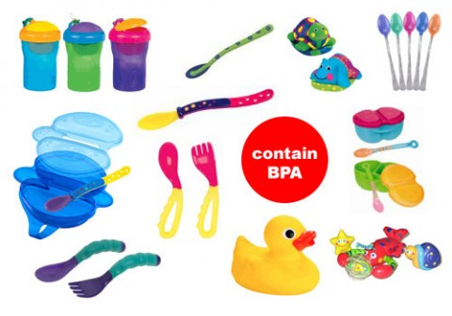
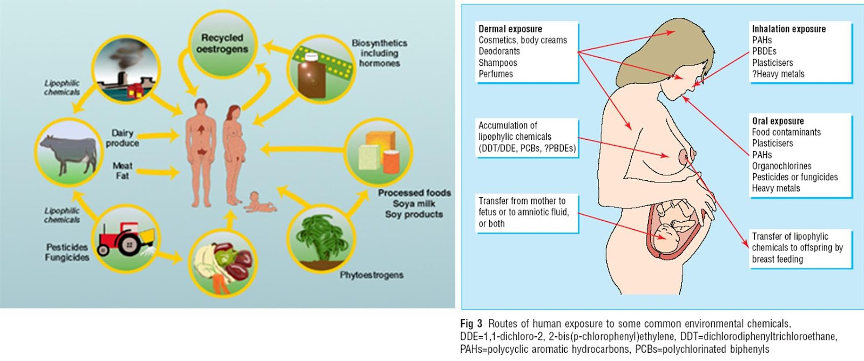
Endocrine disruptors
PBDEs and flame retardants
PCBs
BPA
Phthalates
Pesticides like DDT
Human health effects
Learning disorders
ADD/ADHD
Reduced fertility
Feminization

Slide 39
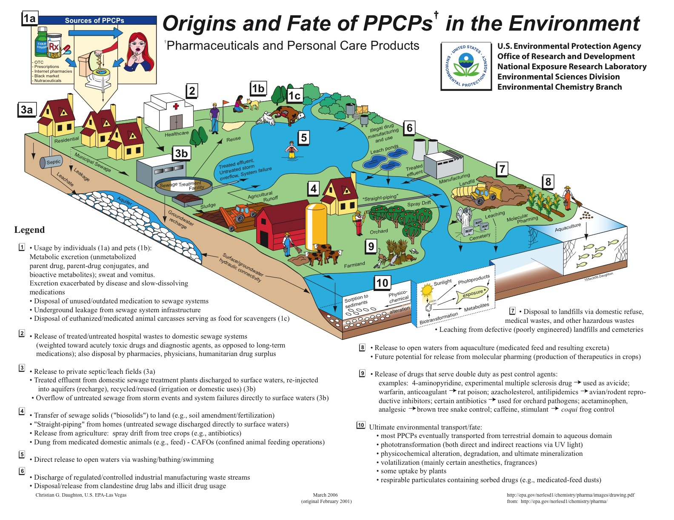

Slide 40
BPA Banned
1. BPA Feels the Heat
Two months after trend-setting California banned the endocrine-disrupting chemical BPA in baby bottles and sippy cups (as of 2013), the federal Food and Drug Administration agreed under the pressure of a law suit to decide whether to eliminate BPA in all food packaging. Meanwhile, the American Chemistry Council, a trade group that has fought fiercely against the California bill and other legislative curbs on BPA, appeared to throw in the towel, at least part way, as it petitioned the U.S. Food and Drug Administration to "clarify for consumers" that it no longer uses the chemical in children's food containers.

Slide 41
West Nile Outbreak
The U.S. experienced one of its worst West Nile virus outbreaks ever, thanks in part to weather conditions. The aerial spraying of pesticides to battle disease-carrying mosquitoes faced opposition from some residents and scientists who argued it's ineffective and potentially dangerous. As one concerned activist told HuffPost's Lynne Peeples, "How many times have they told us something was safe and then 10 years later it comes out that it's not safe?"

Slide 42
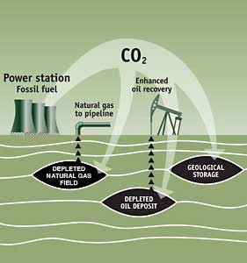
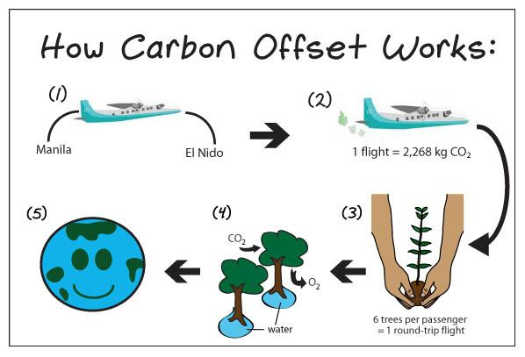
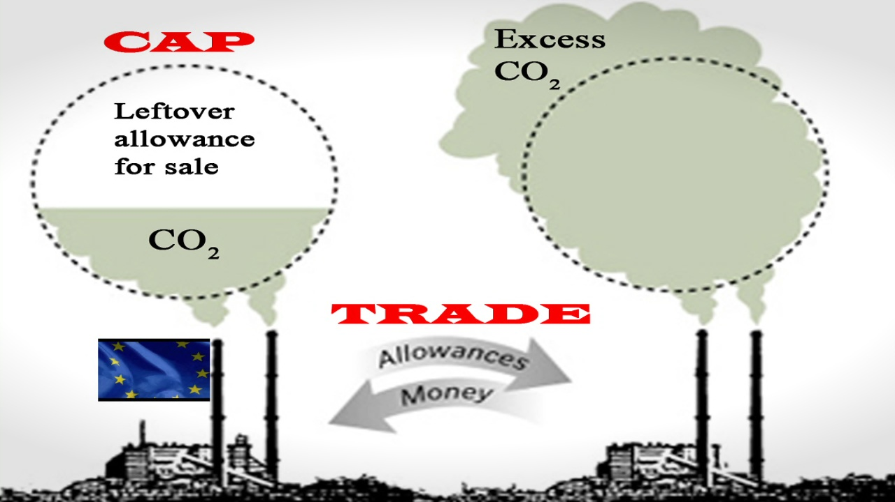
Mitigations for climate change
Reforestation (and afforestation)
Carbon offsets
Cap and trade
CCS

Slide 43
Ocean Acidification
Ocean acidification is the ongoing decrease in the pH of the Earth's oceans, caused by the uptake of carbon dioxide (CO₂) from the atmosphere. An estimated 30–40% of the carbon dioxide from human activity released into the atmosphere dissolves into oceans, rivers and lakes.
Heavily impacts coral and other shell organisms

Slide 44
Consequences of Climate Change
Environmental Consequences
Effect
Receding polar ice caps
Melting of permafrost
Changes atmospheric energy balance – why?
Sea level rise (although due primarily to thermal expansion)
Messes up transportation routes
Releases methane – potent greenhouse gas
Altered climates in various places around the globe

Slide 45
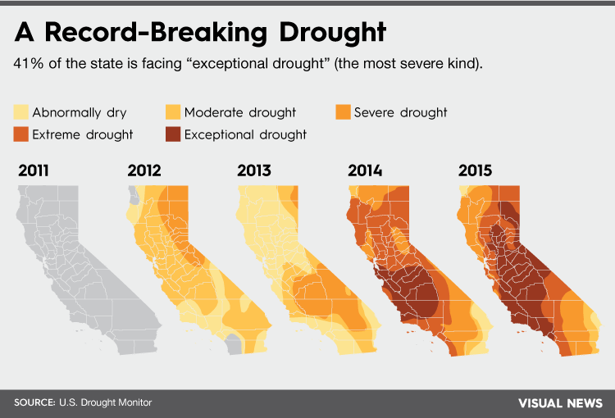
Drought
Areas facing increasing drought due to climate change and excessive human consumption for agriculture.
Texas and California are good case studies
Require change of behavior
Restrictions on water lawns, pools, car washes, etc
Bottled Water industry is big in California, should we allow water to be bottled and sent elsewhere?

Slide 46
Texas Drought
Throughout 2011, Texas experienced its single-worst drought since record keeping began, with an average of 12 inches of rain falling across the state since January. The Drought has also impacted the cattle industry. 600,000 cows, or 12 percent of the state's population, have been moved or slaughtered since January. Interestingly, low water levels and receding lakes have revealed previously-hidden ghost towns, fossils and graves.

Slide 47
Heatwaves
Southwest China’s Sichuan province during a heatwave that pushed thermometers as high as 106 degrees Fahrenheit. The deadly temperatures lasted for weeks, creating the worst heatwave in at least 140 years

Slide 48
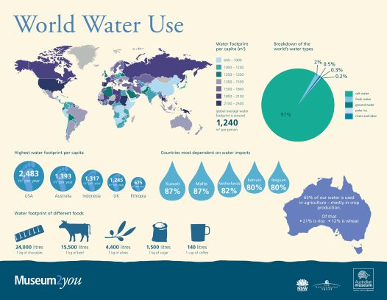
Cape Town Water Crisis - 2018
Cape Town, South Africa - 2nd largest city
Due to three years of consecutive drought, the city has been on significant water restriction
Municipal water: 13 gallons per person
Dam levels were dangerously low
City hopes that annual rains replenish supply
Poor water management and political instability are significant contributors

Slide 49
Drowning Nations
Some low-lying countries and coastal cities grew increasingly concerned this year as projections suggested sea levels could rise, largely due to climate change, up to three feet by the year 2100. Former Maldives President Mohamed Nasheed expressed concern about his country, which could be uninhabitable by 2100, in his new documentary, "The Island President." He warned in a HuffPost interview, “What happens to the Maldivestoday is going to happen to everyone else tomorrow.”

Slide 50
Atmospheric CO₂ Tops 400 PPM
Since 1958, the Mauna Loa Observatory on Hawai‘i’s Big Island has been keeping track of the amount of CO₂ in the atmosphere, and in May its readings crossed a worrisome threshold. For the first time in recorded history, the global concentration of carbon dioxide in the atmosphere is 400 parts per million. The last time Earth had such a high concentration of the heat-trapping gas was about four million years ago – and global temperatures then were 4 degrees Celsius higher than they are today, while global sea levels were between 5 and 40 meters higher. Scientists at Mauna Loa say we’re on track to hit 450 ppm of CO₂ within a few decades – far beyond the 350 ppm level that NASA climatologist James Hansen says is a safe number.

Slide 51
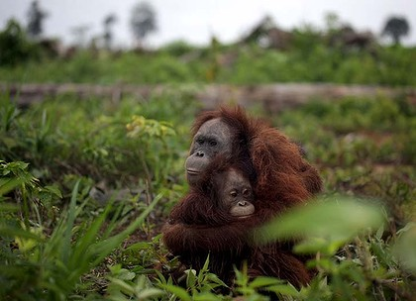
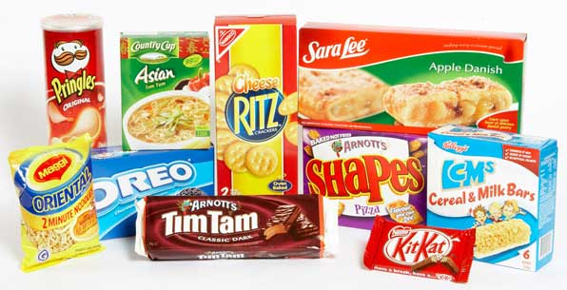
Palm Oil Deforestation
Palm oil
Used in foods and beauty products
Replaces partially hydrogenated oils
Grown in tropics
Deforestation, species loss (orangutans), HIPPCO

Slide 52
Possible FRQ topics
Mass extinction
We are in the middle of the 6th mass extinction
This one is being caused by humans
HIPPCO
Why do we need predators?
Why do we need insects?

Slide 53
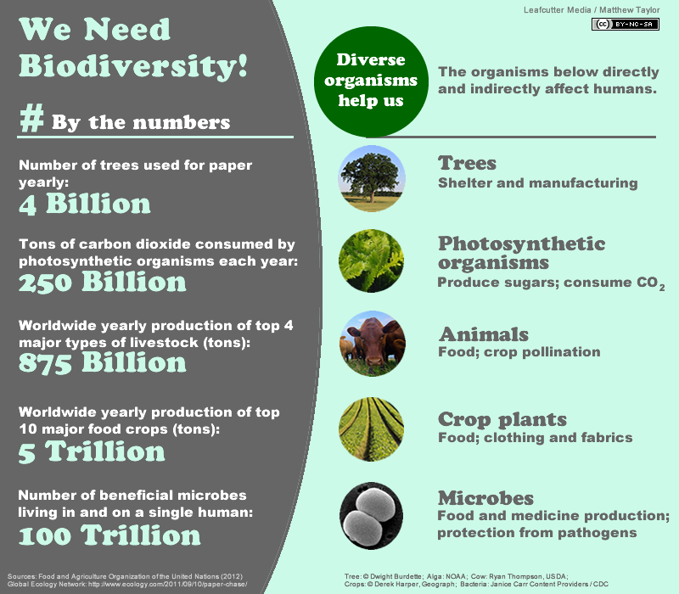
Biodiversity
Cecil the Lion
Mountain Gorillas (CR is involved in this cause)

Slide 54
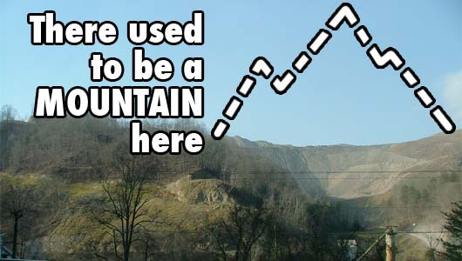
Mountaintop Removal
Major form of mining
W.V. has seen sig changes to its topography
Massive habitat destruction
Regulated by SMCRA

Slide 55
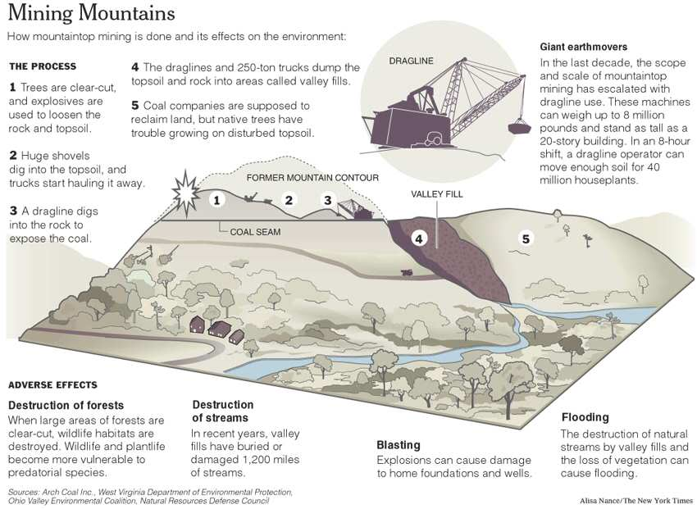

Slide 56
West Virginia mine disaster kills 29, prompts investigations
Mine disaster calls attention to revolving door between industry, government. More than 200 former congressional staff members, federal regulators and lawmakers are employed by the mining industry as lobbyists, consultants or senior executives, including dozens who work for coal companies with the worst safety records in the nation, a Washington Post analysis shows. Washington Post. 18 April 2010. [Registration Required]
Mountaintop coal mining rules may send more miners underground. A U.S. Environmental Protection Agency crackdown on mountaintop mining in Appalachia may force coal producers to rely increasingly on underground sites such as the Massey Energy Co. mine where 29 workers were killed this month in West Virginia.Bloomberg News. 23 April 2010.
Massey under criminal inquiry. Federal agents are interviewing current and former Massey Energy employees as part of a sprawling criminal investigation into the April 5 explosion that killed 29 miners at the company's Upper Big Branch Mine in Raleigh County, according to sources familiar with the inquiry. Charleston Gazette, West Virginia. 2 May 2010.

Slide 57
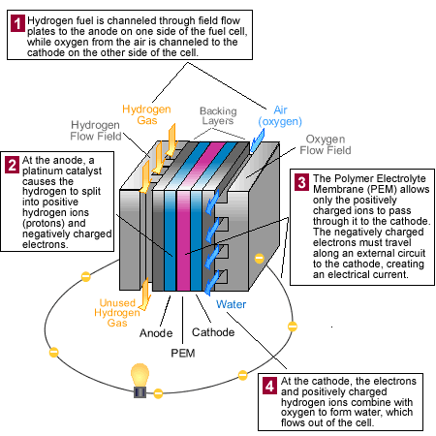
Hydrogen Fuel Cells
Alternative to combustion engines 2H₂ + O₂ → 2H₂O
No emissions
Silent
No recharging
Can use renewable fuels to pull H₂ from water - electrolysis
Fuel itself is efficient
expensive – materials, R&D
Need H₂ – takes energy to extract (often fossil fuels used!) – reduces overall efficiency
Often pulled from CH₄ - Steam reforming (releases greenhouse gases)
Low density – hard to transport
Very flammable, no smell

Slide 58
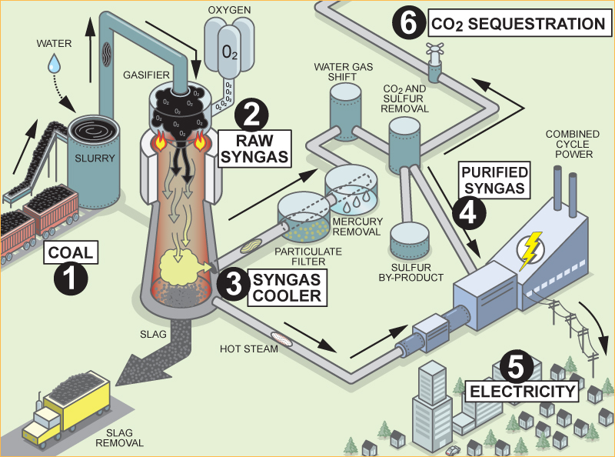
Clean Coal

Slide 59
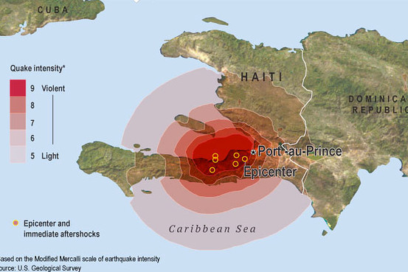
Haiti Earthquake 2010
3 million people affected
>200,000 killed
Magnitude 7.0
Transform Fault Boundary
Why so bad?
Focus’s shallow depth
Highly populous area
Extremely poor country – not well prepared
Basic infrastructure (communication, transportation, water supply) severely damaged
Spread of disease – cholera outbreak

Slide 60
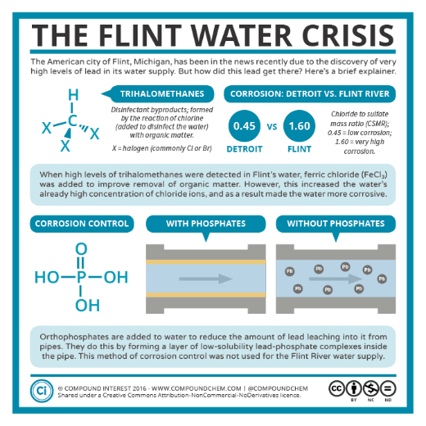
Flint Water Crisis
Very high levels of lead and fecal coliform found in Michigan town
Due to increased use of road salts for melting of snow, poor and outdated piping, and alternative use of water sources (Flint River) that required thihalomathanes due to contamination
40% of town lives below the poverty line
NIMBY
Environmental Refugee?
Lead is a neurotoxin
Shown to cause neurological damage in babies and young children
Bioaccumulation, biomagnification

Slide 61
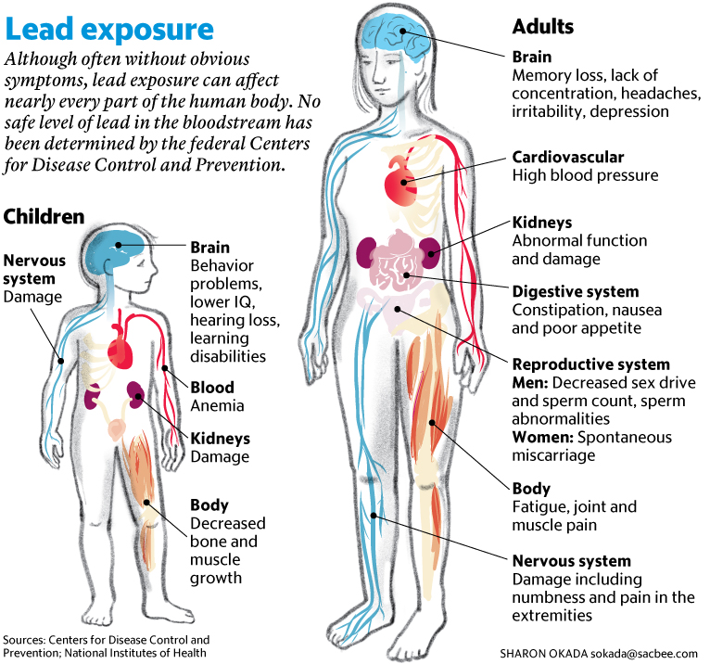

Slide 62
Consider brushing up using this notable toxins ppt by Kristi Schertz

Slide 63
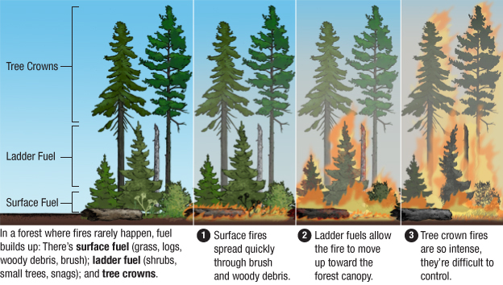
Wildfires
Increasing in severity due to climate change
In rainforest countries - these fires may be part of slash and burn agriculture which uses fires to restore nutrients
Fire Ecology
Setting fires purposefully to maintain ecosystem balance
Crown fires: determinantal - burn too hot and are too destructive
Surface fires: burn understory and deposit nutrients back → promote secondary succession

Slide 65
Wildfires,
Firefighters work near a wildfire burning along a ridge in Yarnell, Ariz., in this photo provided by the U.S. Forest Service. The lightning-sparked fire spread to at least 2,000 acres amid triple-digit temperatures, and overtook an elite group of hotshot firefighters, killing 19 members as they tried to protect themselves from the flames under fire-resistant shields.
Rim Fire, Yosemite National Park, California, August 25, 2013
A firefighter watches for spot fires during a burnout operation while battling the Rim Fire near Yosemite National Park, Calif. The blaze, caused by a hunter’s illegal fire, destroyed more than 30,000 acres of forest and become the third-largest in state history.

Slide 66
Indicator Species
Species that show early signs of distress in an ecosystem that may shadow a larger problem is at play
Frogs are often indicator species as they live in both aquatic and terrestrial environments
Birds are indicator species for air quality due to sensitive lungs “canary in a coal mine”
Aquatic macroinvertebrates signify water quality
Scale -->

Slide 67
Noise Pollution
Anthropogenic usually:
Planes, cars, Geothermal energy production, etc.
Ecological Impacts
Birds are unable to hear mating calls, or find suitable nesting locations
Whales and dolphins: extensive use of sonar disrupts echolocation faculties
Human health impacts
Can cause hearing problems
Anxiety and stress

Slide 68
Super ENSO
Impacted by climate change?
ENSO - naturally occuring
Cold, nutrient rich upwelling is suppressed
Biodiversity impacted
Fishing industry impacted

Slide 70
Agriculture/feeding 10 Billion
Impacted by climate change?
Factory farming increases production, but has impacts:
Animal abuse
Fertilizer use
Energy intensive
Water intensive
Antibiotic resistance
Importance of bees

Slide 71
China drops 1-child policy
Drastically reduced China’s fertility starting in 1981
Smaller workforce
Impacts on declining population
Imbalance in gender
Who cares for the elderly?

Slide 72
Human Population
What are the impacts of a declining population?
Economic loss
Impacts to social security and other programs
People unable to retire

Slide 73
Human Population
I = P x A x T
I = Impact; P = Population; A = Affluence; T = Technology
“Affluence Bomb” -- even if P stabilizes, rising A could lead to increased I unless we focus upon sustainable development.
Rate of change = [b-d] + [i-e]
US population = 310 million & World population = 7.2 billion
Rule of 70 = 70/growth rate = number of years population will double
Total Fertility vs. Replacement Level Fertility
Total Fertility = avg. # children per woman
RLF = avg. # children per woman needed for zero population growth
Strategies to reduce population growth?
Educate/empower women
Decrease poverty
Access to family planning

Slide 74
The following topics have already been tested on, but are good to know…

Slide 75
Possible FRQ topics
Humans – rising affluence in China and India
Demographic transition
I = PxAxT
Influence, population size, affluence, technology
Footprint
Solutions?
HUman Pop on 2017 about TFR

Slide 76
World Population Hits 7 Billion

Slide 77
Dams/rivers
Three Gorges Dam – largest hydroelectric plant
Displaced over a million people from their homes
Erosion of banks of reservoir
Provides “clean energy”, water supply
Dams along with Keystone Species on 2017

Slide 78
Dams/Rivers
Three Gorges Dam – Yangzi River in China
World’s largest hydropower project
Displaced 1.2 million people
Reservoir is polluted from submerged factories, mines, dumps
Erosion on banks of reservoir causing landslides
Worsens drought downstream
BUT… provides “clean” energy, reliable water source

Slide 79
Keystone Species
Dams along with Keystone Species on 2017
Play a larger than expected role in the ecosystem
Cause a trophic cascade in which the impacts of the species “tumble” all the way down
Classic examples:
Gray wolves of Yellowstone
Salmon
Otters

Slide 80
Sewage Treatment
Sewage treatment along with microplastics on 2017
Sewage treatment systems are largely outdated
Primary: removes solid waste (fecal matter, trash, etc) - uses screens
Secondary: removes suspended organic wastes (sugars and fats) - uses aeration tanks and bacteria
Tertiary: removes nitrates and phosphates
Many systems lack tertiary treatment
Some may use chlorine, UV, ozone
All systems lack ability to take out microplastic, microfleece, pharmaceuticals
Natural wetlands can help: phytoremediation, bioremediation

Slide 81
Bee Colony Collapse

Slide 82
Bee Colony Collapse

Slide 83
Shale oil and fracking
USA now producing significant amounts of oil from shale oil in North Dakota
Oil out of rock
Very expensive to produce
USA has a lot of shale oil rock

Slide 84
Truth Will Out: Fracking Has Tainted Ground Water
Giving the lie to gas drillers' long-standing insistence that hydraulic fracturing to release shale oil and gas has never contaminated drinking water supplies, the Environmental Protection Agency announced that it had detected chemicals associated with fracking in groundwater in Wyoming. Earlier, EWG's own investigation uncovered a long-forgotten 1987 EPA report that found fracking-related contamination in water wells used by West Virginia residents. In the face of mounting public pressure, meanwhile,regulators decided to postpone action on rules that could open the door to widespread drilling and fracking in the vast Delaware River watershed.

Slide 85
Tar Sands - on FRQ 2011 #3
Energy - Tar sands (oil sands)
Keystone XL pipeline over prime ag land and Ogallala aquifer
Bitumen
Found under an old growth boreal forest
Ecosystem services of forests – CO2 sink
Low net energy
Very dirty
Surface mining
Toxic tailings ponds
Continued reliance of oil

Slide 86
The following are general reminders for the exam

Slide 87
Important Vocab
Greatest good for greatest number?
Controlled use
Remaining wilderness areas of public land should be left untouched
Bring back to former condition
Associated with cleanup of chemical contaminants in a polluted area
Repairing/rehabilitating a damaged ecosystem or compensation for damage – substitute or replacement area (common with wetlands)
Chemical and physical manipulations in severely degraded sites like open pit mines
Conservation
Preservation
Restoration
Remediation
Mitigation
Reclamation

Slide 88
Important Vocab continued….
Anthropogenic - man/human centered ie: an anthropogenic source of CO2
Mortality - death rate, ie: infant mortality rate during the transitional stage…

Slide 89
Final things to remember. . .
Layers of atmosphere: These Spheres Mask The Earth
CO2 is not a traditional air pollutant, it’s a GHG.
Fertilizers and pesticides are NOT the same. Fertilizers have N,P,K for plant growth. Pesticides kill bugs. Know about problems of each.
An ecological/ecosystem "cost" is NOT about money, it’s about a problem in an ecosystem. A question about $ will have the word "economic".
Stratospheric ozone thinning (hole) and global warming are NOT the same thing.
For air pollution questions, all pollutants except lead cause "respiratory problems such as asthma"
Advantage for any biome, ecosystem service, habitat = ecotourism, aesthetic value
Ecological impacts can almost always be habitat destruction which leads to a decrease in biodiversity
Ways to get people to do things are almost always education.
We subsidize behavior we do like, tax things we don’t like.

Slide 90
Final things to remember. . .
Review experimental design: dependent & independent variables, hypothesis with "increasing/decreasing" in it.
Use the words "money" or "jobs" for economic questions. For govt. incentives: subsidies, tax credit/rebates, cap and trade. Disincentives include taxes, fines, legal penalties, property value loss
Eutrophication: excess nutrients (N,P) from fertilizer, manure or urban sewage are washed by rain into rivers which flow to the ocean => algal/phytoplankton bloom then die-off from lack of light => decomposed by bacteria who use all the oxygen => hypoxia and fish death => anaerobic mess
When talking about change in an ecosystem, use "increasing" or "decreasing". Ex: Invasive species cause native species population to decrease
Review the nitrogen cycle! The AP exam LOVES the nitrogen cycle.
If you can’t think of other possible solutions to problems, use education (but indicate what we should educate about).
Notes:
Review the nitrogen cycle! The AP exam LOVES the nitrogen cycle.

Slide 91
Final things to remember. . .
An ecosystem service is defined as something nature provides humans for survival or economic benefit. NOT something nature gives itself.
#1 way to control population growth is to provide education (literacy) for girls. Girls marry later, and have less children. Lowers poverty.
Try the Rule of 70 for growth rate.
Food chains always begin with a producer. Arrows point the direction of energy flow (toward the predator).
Anthropogenic = human made. Degradation = decline in quality. Synthetic = not natural.
Loss of biodiversity → HIPPCO
Sustainability = protect natural cycles + true pricing + renewable energy + biodiversity + population control

Slide 92
Important Laws
Coastal Management Act
Corporate Average Fuel Economy (CAFE standards)
Clean Air Act
Clean Water Act
Comprehensive Environmental Response, Compensation Liability Act (CERCLA)
Manages coastal resources (including Great Lakes) – balances economic development with conservation
Sets minimum fuel economy standards
Establishes primary and secondary air quality standards for 6 criteria pollutants (SO2, NOx, CO, PM, O3, Pb)
Regulates discharge into water sources and wetland destruction (water looks)
Provides funds for clean-up of hazardous substances (Superfund Sites): largely not effective

Slide 93
Important Laws
Convention on International Trade in Endangered Species (CITES)
Endangered Species Act (ESA)
Federal Insecticide, Fungicide, and Rodenticide Act (FIFRA)
Kyoto Protocol
International legislation banning hunting, selling, importing endangered species
Protects threatened and endangered species and their habitats – involves recovery plan
Requires that pesticides are registered and approved by the FDA
Agreement among 150 nations requiring greenhouse gas emissions reduction - USA didn’t ratify

Slide 94
Important Laws
Montreal Protocol
National Environmental Policy Act (NEPA)
National Forest Management Act
Banned production of aerosols and initiated the phasing out of CFCs
Requires environmental impact statement for every major federal project
Sets standards for how the Forest Service manages National Forests – requires land management plans for national forests and grasslands

Slide 95
Important Laws
Resource Conservation and Recovery Act (RCRA)
Safe Drinking Water Act
Surface Mining Control and Reclamation Act
Toxic Substances Control Act
Management of solid waste including landfills and storage tanks – set minimum standards for all waste disposal (including hazardous waste)
Sets standards for drinking water quality (how water tastes)
Requires restoration of abandoned mines
Tracks 75,000 industrial chemicals – tested for environmental or health hazard and banned if high risk

